Slide 1




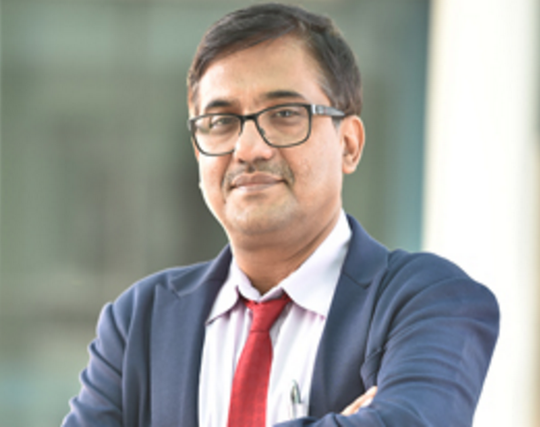

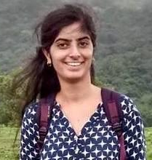
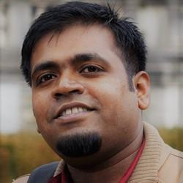

Unsupervised Neural Machine Translation
Tutorial @ ICON-2020
IIT Patna
Jyotsana Khatri
Tamali Banerjee
Diptesh Kanojia
Prof. Pushpak Bhattacharyya
Rudra Murthy

Slide 2
Paradigms of Machine Translation
Pushpak Bhattacharyya
Acknowledgement: Numerous PhD, masters and UG students and research staff working on MT with me since 2000

Slide 3
Perspective

Slide 4
NLP: a useful view
Problem
Semantics
NLP
Trinity
Parsing
Part of Speech
Tagging
Discourse and Coreference
Increased
Complexity
Of
Processing
Morph
Analysis
Semantics
Marathi
French
HMM
Parsing
Hindi
English
Language
CRF
MEMM
Algorithm
Chunking
POS tagging
Morphology

Slide 5
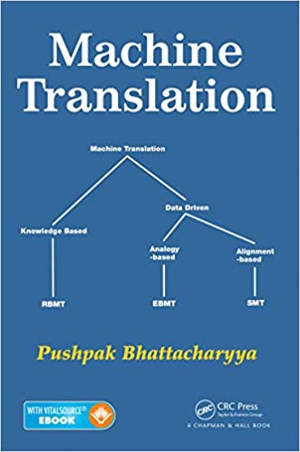
Machine Translation: Translating
from one language to another by computer
Machine Translation
RBMT- rule based MT
EBMT- example based MT
SMT- Statistical MT
NMT- Neural MT
Data Driven
Knowledge Based:
Essence- Analysis
Probability based:
Essence- Alignment
Distributed Representation
based:
Essence- Attention?
Similarity based:
Essence- Analogy
RBMT (rule based)
SMT
(statistical)
EBMT
(example based)
NMT
(neural)
Interlingua
based
transfer
based

Slide 6
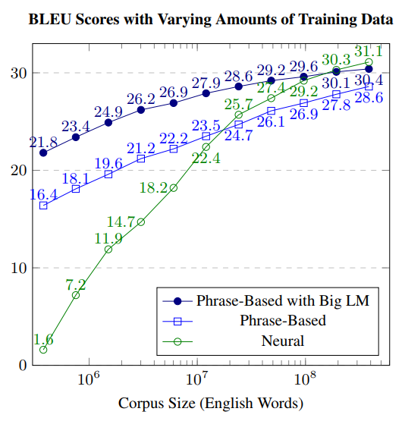
Today’s Ruling Paradigm: NMT which is data intensive
Philipp Koehn and Rebecca Knowles. 2017. Six Challenges for Neural Machine Translation. In Proceedings of the First Workshop on Neural Machine Translation, pages 28–39.

Slide 7
Essential Elements of MT Paradigms
Analysis in RBMT
Alignment in SMT
Analogy in EBMT
Attention in NMT?

Slide 8
Challenge of MT: Language Divergence
Languages have different ways of expressing meaning
Lexico-Semantic Divergence
Structural Divergence
Our work on English-IL Language Divergence with illustrations from Hindi
(Dave, Parikh, Bhattacharyya, Journal of MT, 2002)

Slide 9
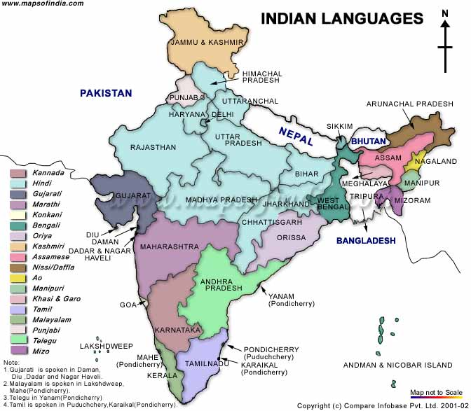
Different ways of expressing meaning
English:
This blanket is very soft
Hindi:
yaha kambal bahut naram hai
Bangla:
ei kambal ti khub naram <null>
Marathi:
haa kambal khup naram aahe
Manipuri:
kampor asi mon mon laui
blanket this soft soft is
Hindi
Marathi
Bengali
Manipuri
English

Slide 10
Kinds of MT Systems (point of entry from source to the target text)
(Vauquois. 1968)

Slide 11
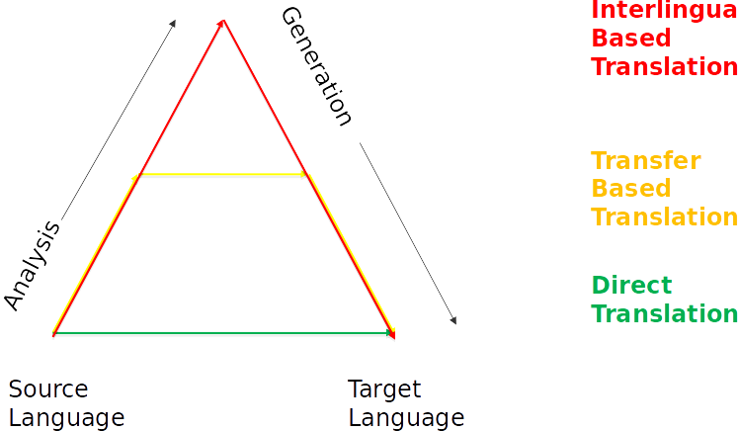
Simplified Vauquois

Slide 12
Differentiating Interlingual and Transfer based MT: TBMT can choose the level of transfer! Need to emphasise this point
राजा को नमन करो (Hindi; Indo Aryan)
raajaa ko naman karo
HG: king to obeisance do
Give obeisance to the king (English; Indo-Aryan)
राजाला नमन करा (Marathi; Indo Aryan)
raajaalaa naman karaa
king_to obeisance do
அரசரை வணங்கு (Tamil; Dravidian)
aracarai vanaNku
king_to obeisance_do
নিংথৌবু খইরম্মু (Manipuri; Tibeto Burman)
niNgthoubu khoirammu
king_to obeisance do

Slide 13
transfer amongst different language families
Language | Inflected Verb/Inflected verb complex | Inflected Noun/Inflected Noun chunk
English | give obeisance | To the king
Hindi | naman karo | raajaa ko
Marathi | naman karaa | raajaalaa
Tamil | vanaNku | aracarai
Manipuri | Khoirammu | niNgthoubu

Slide 14
English parse tree
Transfer rules:
VC-PP inversion (all languages)
VC
V-NI inversion (H & M: naman karo, naman karaa)
V-NI combination → nominal verb with appropriate inflection (T, Mn: vanaNku, khoirammu)
PP
PP inversion with P becoming a postposition (H: raajaa ko)
suffixed form of ‘king’ expressing accusative case (M, T, Mn: raajaalaa, aracarai, niNgthoubu)
S
VP
VC
PP
V
NI
P
NP
Give
obeisance
to
The king

Slide 15
Rule based MT (typical architecture)
Source Text
Target Text
Morphological
Analyzer
Word
Generator
POS Tagger
Interchunk
Chunker
Analysis
Generation
Intrachunk
Vibhakti
Computation
Agreement
Feature
Name Entity
Recognizer
Transfer
Word Sense Disambiguation
Lexical Transfer

Slide 16
Statistical Machine Translation

Slide 17
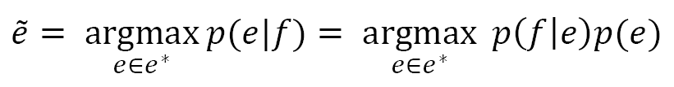
Foundation
Data driven approach
Goal is to find out the English sentence e given foreign language sentence f whose p(e|f) is maximum.
Translations are generated on the basis of statistical model
Parameters are estimated using bilingual parallel corpora

Slide 18
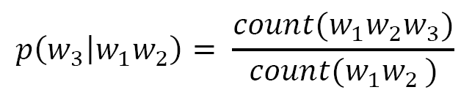
SMT: Language Model
To detect good English sentences
Probability of an English sentence w₁w₂ …… w_{n} can be written as
Pr(w₁w₂ …… w_{n}) = Pr(w₁) * Pr(w₂|w₁) *. . . * Pr(w_{n}|w₁ w₂ . . . w_{n-1})
Here Pr(w_{n}|w₁ w₂ . . . w_{n-1}) is the probability that word w_{n} follows word string w₁ w₂ . . . w_{n-1}.
N-gram model probability
Trigram model probability calculation

Slide 19
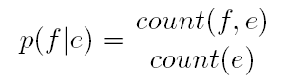
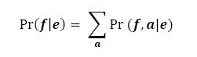
SMT: Translation Model
P(f|e): Probability of some f given hypothesis English translation e
How to assign the values to p(e|f) ?
Sentences are infinite, not possible to find pair(e,f) for all sentences
Introduce a hidden variable a, that represents alignments between the individual words in the sentence pair
Sentence level
Word level

Slide 20
Alignment
If the string, e= e₁^{l}= e₁ e₂ …e_{l}, has l words, and the string, f= f₁^{m}=f₁f₂...f_{m}, has m words,
then the alignment, a, can be represented by a series, a₁^{m}= a₁a₂...a_{m} , of m values, each between 0 and l such that if the word in position j of the f-string is connected to the word in position i of the e-string, then
a_{j}= i, and
if it is not connected to any English word, then a_{j}= O

Slide 21
Example of alignment
English: Ram went to school
Hindi: raam paathashaalaa gayaa
Ram went to school
<Null> raam paathashaalaa gayaa

Slide 22
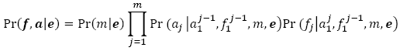
Translation Model: Exact expression
Choose the length of foreign language string given e
Choose alignment given e and m
Choose the identity of foreign word given e, m, a
Five models for estimating parameters in the expression [2]
Model-1, Model-2, Model-3, Model-4, Model-5

Slide 23
Proof of Translation Model: Exact expression
; marginalization
; marginalization
m is fixed for a particular f, hence

Slide 24
Alignment

Slide 25
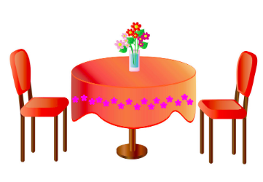

How to build part alignment from whole alignment
Two images are in alignment: images on the two retina
Need to find alignment of parts of it

Slide 26
Fundamental and ubiquitous
Spell checking
Translation
Transliteration
Speech to text
Text to Speech

Slide 27
The all important word alignment
The edifice on which the structure of SMT is built (Brown et. Al., 1990, 1993; Och and Ney, 1993)
Word alignment → Phrase alignment (Koehn et al, 2003)
Word alignment → Tree Alignment (Chiang 2005, 2008; Koehn 2010)
Alignment at the heart of Factor based SMT too (Koehn and Hoang 2007)

Slide 28
EM for word alignment from sentence alignment: example
English
three rabbits
a b
rabbits of Grenoble
b c d
French
trois lapins
w x
(2) lapins de Grenoble
x y z

Slide 29
Initial Probabilities: each cell denotes t(a←→ w), t(a←→ x) etc.
 | a | b | c | d
w | 1/4 | 1/4 | 1/4 | 1/4
x | 1/4 | 1/4 | 1/4 | 1/4
y | 1/4 | 1/4 | 1/4 | 1/4
z | 1/4 | 1/4 | 1/4 | 1/4

Slide 30
Example of expected count
C[w←→a; (a b)←→(w x)]
t(w←→a)
= ------------------------- X #(a in ‘a b’) X #(w in ‘w x’)
t(w←→a)+t(w←→b)
1/4
= ----------------- X 1 X 1= 1/2
1/4+1/4

Slide 31
“counts”
a b ←→ w x | a | b | c | d
w | 1/2 | 1/2 | 0 | 0
x | 1/2 | 1/2 | 0 | 0
y | 0 | 0 | 0 | 0
z | 0 | 0 | 0 | 0
b c d ←→ x y z | a | b | c | d
w | 0 | 0 | 0 | 0
x | 0 | 1/3 | 1/3 | 1/3
y | 0 | 1/3 | 1/3 | 1/3
z | 0 | 1/3 | 1/3 | 1/3

Slide 32
Revised probability: example
t_{revised}(a←→ w)
1/2
= -------------------------------------------------------------------
(1/2+1/2 +0+0 )_{(a b)←→( w x)} +(0+0+0+0 )_{(b c d)←→ (x y z)}

Slide 33
Revised probabilities table
 | a | b | c | d
w | 1/2 | 1/2 | 0 | 0
x | 1/4 | 5/12 | 1/6 | 1/6
y | 0 | 1/3 | 1/3 | 1/3
z | 0 | 1/3 | 1/3 | 1/3

Slide 34
“revised counts”
a b ←→ w x | a | b | c | d
w | 1/2 | 3/8 | 0 | 0
x | 1/2 | 5/8 | 0 | 0
y | 0 | 0 | 0 | 0
z | 0 | 0 | 0 | 0
b c d ←→ x y z | a | b | c | d
w | 0 | 0 | 0 | 0
x | 0 | 5/9 | 1/3 | 1/3
y | 0 | 2/9 | 1/3 | 1/3
z | 0 | 2/9 | 1/3 | 1/3

Slide 35
Re-Revised probabilities table
 | a | b | c | d
w | 1/2 | 1/2 | 0 | 0
x | 3/16 | 85/144 | 1/9 | 1/9
y | 0 | 1/3 | 1/3 | 1/3
z | 0 | 1/3 | 1/3 | 1/3
Continue until convergence; notice that (b,x) binding gets progressively stronger;
b=rabbits, x=lapins

Slide 36
Derivation of EM based Alignment Expressions
E¹
what is in a name ?
नाम में क्या है ?
naam meM kya hai ?
name in what is ?
F¹
E²
That which we call rose, by any other name will smell as sweet.
जिसे हम गुलाब कहते हैं, और भी किसी नाम से उसकी कुशबू समान मीठा होगी
Jise hum gulab kahte hai, aur bhi kisi naam se uski khushbu samaan mitha hogii
That which we rose say , any other name by its smell as sweet
That which we call rose, by any other name will smell as sweet.
F²

Slide 37
Vocabulary mapping
Vocabulary
V_{E} | V_{F}
what , is , in, a , name , that, which, we , call ,rose, by, any, other, will, smell, as, sweet | naam, meM, kya, hai, jise, ham, gulab, kahte, aur, bhi, kisi, bhi, uski, khushbu, saman, mitha, hogii

Slide 38
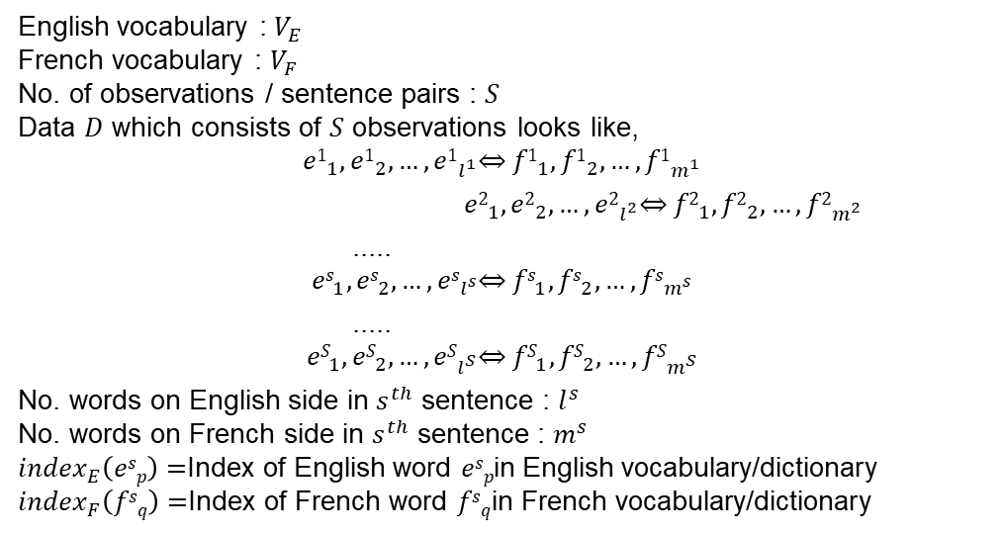
Key Notations
English vocabulary : $V_{E}$
French vocabulary : $V_{F}$
No. of observations / sentence pairs : $S$
Data $D$ which consists of $S$ observations looks like,
$${e1}_{1}, {e1}_{2},…, {e1}_{l^{1}}\overset{⇔}{} {f1}_{1}, {f1}_{2},…, {f1}_{m^{1}}$$
$${ e2}_{1}, {e2}_{2},…, {e2}_{l^{2}}\overset{⇔}{} {f2}_{1}, {f2}_{2},…, {f2}_{m^{2}}$$
.....
$${es}_{1}, {es}_{2},…, {es}_{l^{s}}\overset{⇔}{} {fs}_{1}, {fs}_{2},…, {fs}_{m^{s}}$$
.....
$${eS}_{1}, {eS}_{2},…, {eS}_{l^{S}}\overset{⇔}{} {fS}_{1}, {fS}_{2},…, {fS}_{m^{S}}$$
No. words on English side in $s^{th}$ sentence : $l^{s}$
No. words on French side in $s^{th}$ sentence : $m^{s}$
${index}_{E}\left(esp\right)=$Index of English word $esp$in English vocabulary/dictionary
${index}_{F}\left(fsq\right)=$Index of French word $fsq$in French vocabulary/dictionary
(Thanks to Sachin Pawar for helping with the maths formulae processing)

Slide 39
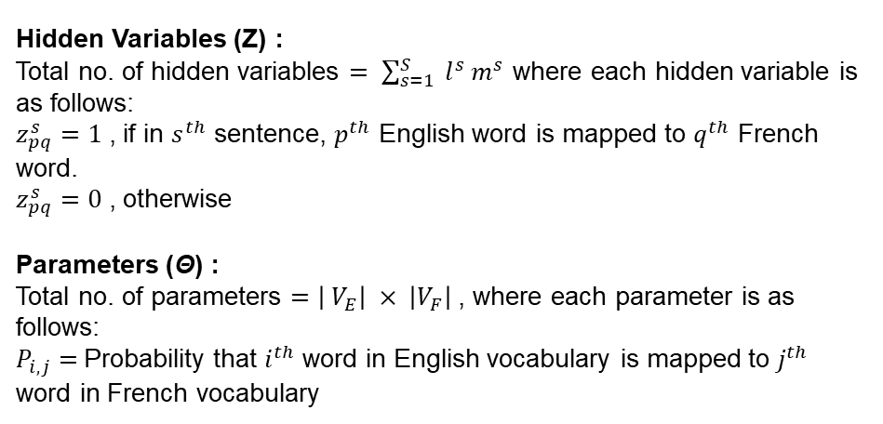
Hidden variables and parameters
Hidden Variables (Z) :
Total no. of hidden variables $= \sum_{s=1}^{S}{ l^{s} m^{s}}$ where each hidden variable is as follows:
$z_{pq}^{s}=1$ , if in $s^{th}$ sentence, $p^{th}$ English word is mapped to $q^{th}$ French word.
$z_{pq}^{s}=0$ , otherwise
Parameters (Θ) :
Total no. of parameters $=\left| V_{E}\right| × \left|V_{F}\right|$, where each parameter is as follows:
$P_{i,j}=$Probability that $i^{th}$ word in English vocabulary is mapped to $j^{th}$ word in French vocabulary

Slide 40
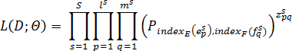
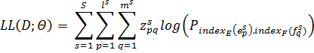
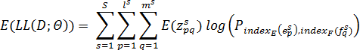
Likelihoods
Data Likelihood L(D; Θ) :
Data Log-Likelihood LL(D; Θ) :
Expected value of Data Log-Likelihood E(LL(D; Θ)) :

Slide 41
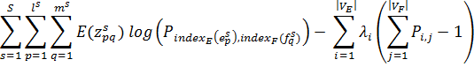

Constraint and Lagrangian
$$\sum_{j=1}^{\left|V_{F}\right|}{P_{i,j}}=1 , ∀i$$

Slide 42
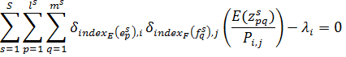
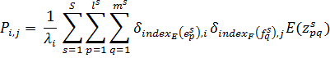
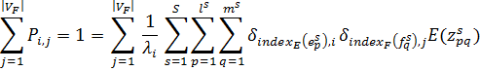
Differentiating wrt P_{ij}

Slide 43
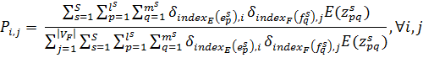
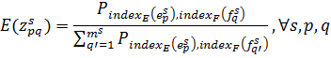
Final E and M steps
M-step
E-step

Slide 44
PAN Indian SMT (whole word and subword)
Anoop Kunchukuttan, Abhijit Mishra, Rajen Chatterjee, Ritesh Shah and Pushpak Bhattacharyya, Shata-Anuvadak: Tackling Multiway Translation of Indian Languages, LREC 2014, Rekjyavik, Iceland, 26-31 May, 2014
Kunchukuttan & Bhattacharyya (EMNLP 2016)

Slide 45
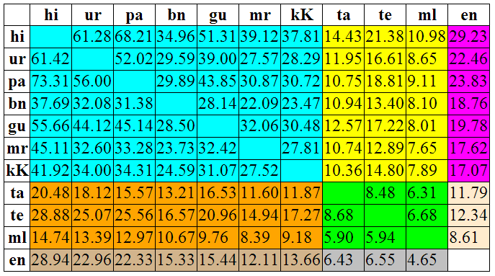
Indian Language SMT (2014)
Baseline PBSMT - % BLEU scores (S1)
Clear partitioning of translation pairs by language family pairs, based on translation accuracy.
Shared characteristics within language families make translation simpler
Divergences among language families make translation difficult
(Anoop Kunchukuttan, Abhijit Mishra, Pushpak Bhattacharyya, LREC 2014)

Slide 46
EBMT

Slide 47
Nagao’s seminal paper 1984 (1/2)
“Man does not translate a simple sentence by doing deep linguistic analysis, rather, man does the translation, first, by properly decomposing an input sentence into certain fragmental phrases (very often, into case frame units), and then
… (p.t.o)

Slide 48
Nagao’s seminal paper 1984 (2/2)
by translating these fragmental phrases into other language phrases, and finally by properly composing these fragmental translations into one long sentence. The translation of each fragmental phrase will be done by the analogy translation principle with proper examples as its reference”

Slide 49
ALIGNMENT
transfer
RECOMBINATION
generation
MATCHING
analysis
EXACT MATCH
direct translation
Source text
Target text
The “Vauquois pyramid” adapted for EBMT

Slide 50
Analogy: the crux of the matter (need to emphasise)
Needs measure of similarity
similar texts should indeed be measured as similar and dissimilar ones as dissimilar
Means and Resources for measuring similarity.

Slide 51
Different ways of measuring text similarity
Bag of words (BoW) based
Permutation based
N-gram based
Vector based
Tree based
Semantic graph based
Feature based

Slide 52
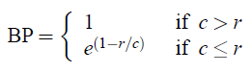
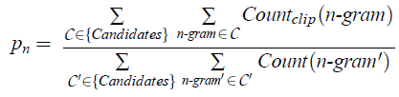
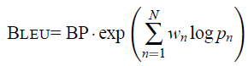
N-gram based matching: BLEU score
Precision -> Modified n-gram precision
Recall -> Brevity Penalty
C: candidate sentence(s); C’: reference sentence(s); clip: to clip the count
to max number of occurrences of an n-gram in the corpus; wn: weightage
to a particular n-gram precision

Slide 53
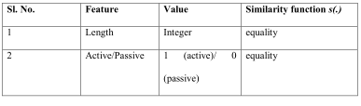
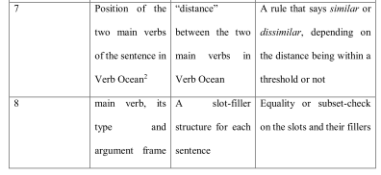
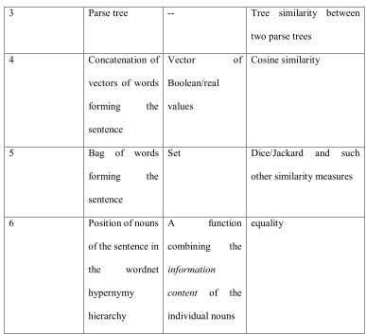
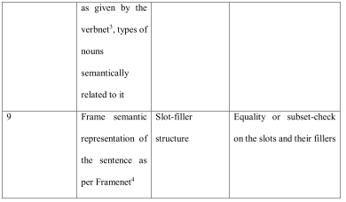
Feature based (very rich)

Slide 54
EBMT’s ‘decoding’: RECOMBINATION
Null Adaptation
Re-instantiation
Abstraction and re-specialization
Case based substitution
Semantic graph or graph-part substitution

Slide 55
Example of re-instantiation
Input: Tomorrow, today will be yesterday
Example matched: Yesterday, today was tomorrow
कल, आज कल था
kal, aaj kal thaa
Yesterday, today tomorrow was
(kal is ambiguous in Hindi standing for both ‘yesterday’ and ‘tomorrow’)

Slide 56
Re-instantiation: adjustments (boundary friction problem)
Yesterday, today, and tomorrow are all hyponyms of day.
Main predicates in the example sentence and the input sentences was and will be.
So, adjusting for the difference in predicates and matching the arguments, the translation is obtained as:

Slide 57
Re-instantiation leading to translation
कल, आज कल होगा
kal, aaj kal hogaa
HG: Tomorrow, today yesterday will_be

Slide 58
Neural Machine Translation

Slide 59
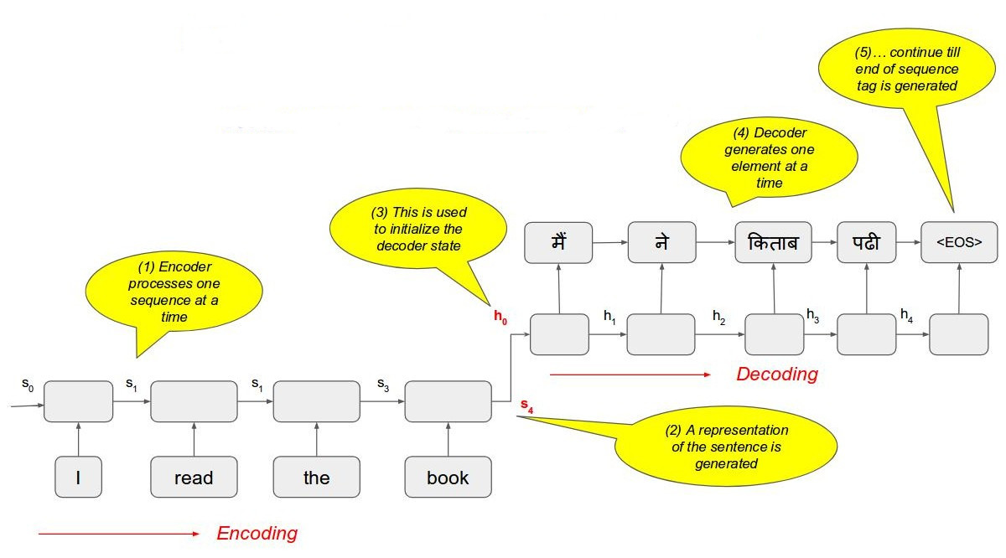
Encoder-Decoder model
Image source- http://www.iitp.ac.in/~shad.pcs15/data/nmt-rudra.pdf
Notes:
Must explain issue with this

Slide 60
Some representative accuracy figure for Indian Language NMT
Language pair | BLEU score
Hi - Mr | 31.25
Hi - Pa | 63.38
Pa - Hi | 68.31
Hi - Gu | 49.98
Gu - Hi | 53.22 ( ↑ from 53.09 from SMT)

Slide 61
Comparing Knowledge based and data driven MT- with an example

Slide 62
Illustration of difference of RBMT, EBMT, SMT+NMT
Peter has a house
Peter has a brother
This hotel has a museum

Slide 63
The tricky case of ‘have’ translation
English
Marathi
Peter has a house
Peter has a brother
This hotel has a museum
पीटरकडे एक घर आहे/ piitar kade ek ghar aahe
पीटरला एक भाऊ आहे/ piitar laa ek bhaauu aahe
ह्या हॉटेलमध्ये एक संग्रहालय आहे/ hyaa hotel madhye ek saMgrahaalay aahe

Slide 64
RBMT
If
syntactic subject is animate AND syntactic object is owned by subject
Then
“have” should translate to “kade … aahe”
If
syntactic subject is animate AND syntactic object denotes kinship with subject
Then
“have” should translate to “laa … aahe”
If
syntactic subject is inanimate
Then
“have” should translate to “madhye … aahe”

Slide 65
EBMT
X have Y →
X_kade Y aahe /
X_laa Y aahe /
X_madhye Y aahe

Slide 66
SMT
has a house ←→ kade ek ghar aahe
<cm> one house has
has a car ←→ kade ek gaadii aahe
<cm> one car has
has a brother ←→ laa ek bhaau aahe
<cm> one brother has
has a sister ←→ laa ek bahiin aahe
<cm> one sister has
hotel has ←→ hotel madhye aahe
hotel <cm> has
hospital has ←→ haspital madhye aahe
hospital <cm> has

Slide 67
SMT: new sentence
“This hospital has 100 beds”
n-grams (n=1, 2, 3, 4, 5) like the following will be formed:
“This”, “hospital”,… (unigrams)
“This hospital”, “hospital has”, “has 100”,… (bigrams)
“This hospital has”, “hospital has 100”, … (trigrams)
DECODING !!!

Slide 68
IL-NLP: Challenges

Slide 69
Challenges of IL Computing (1/2)
Scale and Diversity: 22 major languages in India, written in 13 different scripts, with over 720 dialects
Code Mixing (“kyo ye hesitation?”); Gerundification (“gaadi chalaaoing”)
Absence of basic NLP tools and resources: ref nlp pipeline
Absence of linguistic tradition for many languages
Pushpak Bhattacharyya, Hema Murthy, Surangika Ranathunga and Ranjiva Munasinghe, Indic Language Computing, CACM, V 62(11), November 2019.

Slide 70
ILT Challenges (2/2)
Script complexity and non-standard input mechanism: InScript Non-optimal
Non-standard transliteration (“mango”→ ‘am”, “aam”, Am”)
Non-standard storage: proprietary fonts
Challenging language phenomena: Compound verbs (“has padaa”), morph stacking (“gharaasamorchyaanii”)
Resource Scarcity

Slide 71
Mitigating the Resource problem

Slide 72
Three ways (1/2)
(1) Artificially boost the resource
Subword based NLP
Characters, Syllables, Orthographic Syllables, Byte Pair Encoding
Given, “khaa+uMgaa → will+eat” AND “jaa+rahaa_hE → is+going”
Produce “khaa+rahaa_hE→ is+eatin

Slide 73
Three ways (2/2)
(2) Take help from another language
Cooperative NLP
(3) Use “higher level language properties”
e.g., Part of Speech, Sense ID etc.

Slide 74
But there is a pitfall- NLP’s “Law of Trade off”
Trade Off:
Precision vs. Recall
Sparsity vs. Ambiguity
Information_Injection vs. Topic_Drift

Slide 75
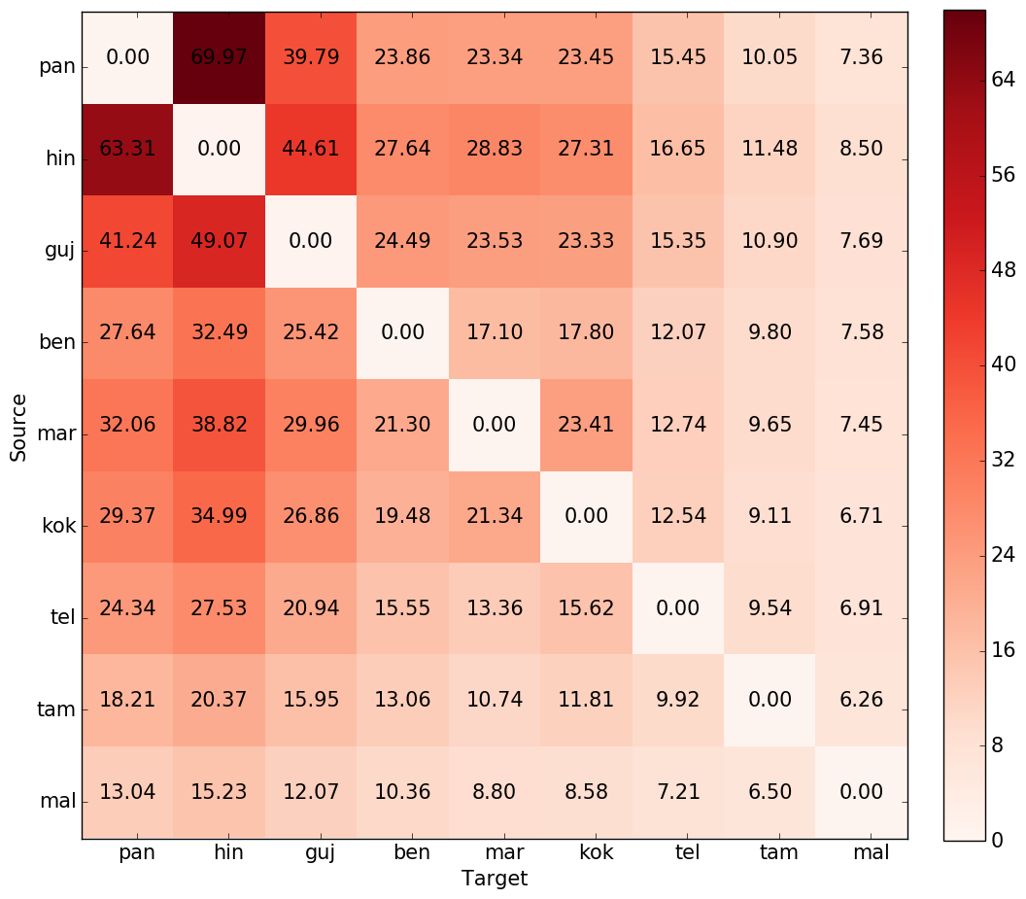
Word level translation (BLEU scores)
Indo-Aryan
Dravidian
Clear Partitioning based on language families
Translation between Indo Aryan languages is easiest
Indo-Aryan
Translation into Dravidian languages is particularly difficult
Dravidian

Slide 76
Methods of sub-wording

Slide 77
Subwords (for “jaauMgaa”)
Characters: “j+aa+u+M+g+aa”
Morphemes: “jaa”+”uMgaa”
Syllables: “jaa”+”uM”+”gaa”
Orthographic syllables: “jaau”+”Mgaa”
BPE (depends on corpora, statistically frequent patterns): both “jaa” and “uMgaa” are likely

Slide 78
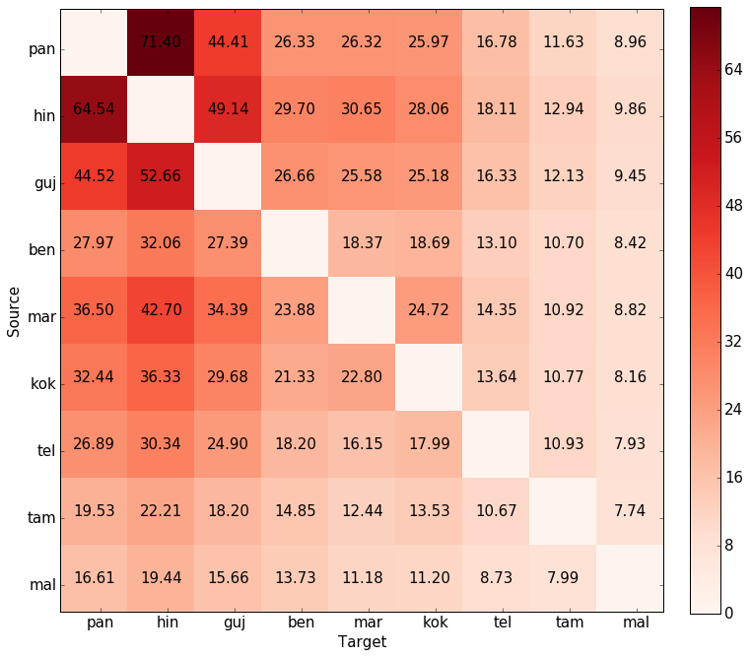
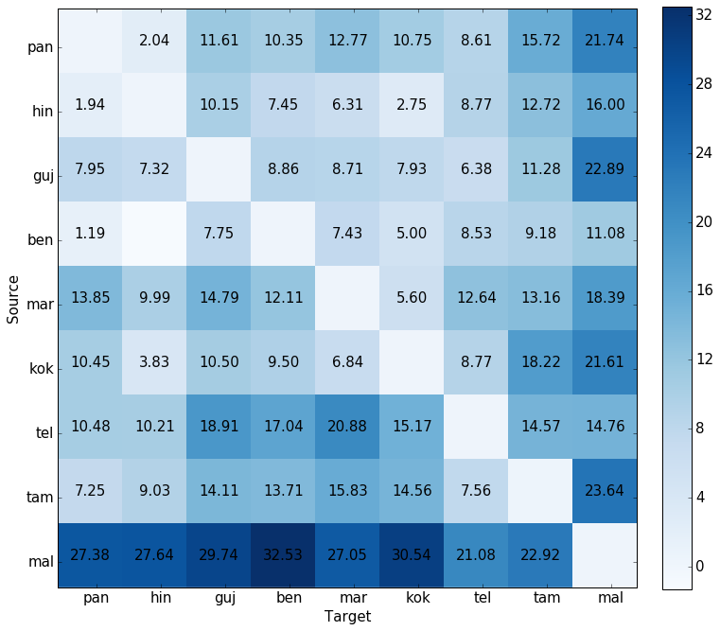
Morph level translation
BLEU scores
% improvement over word level scores

Slide 79
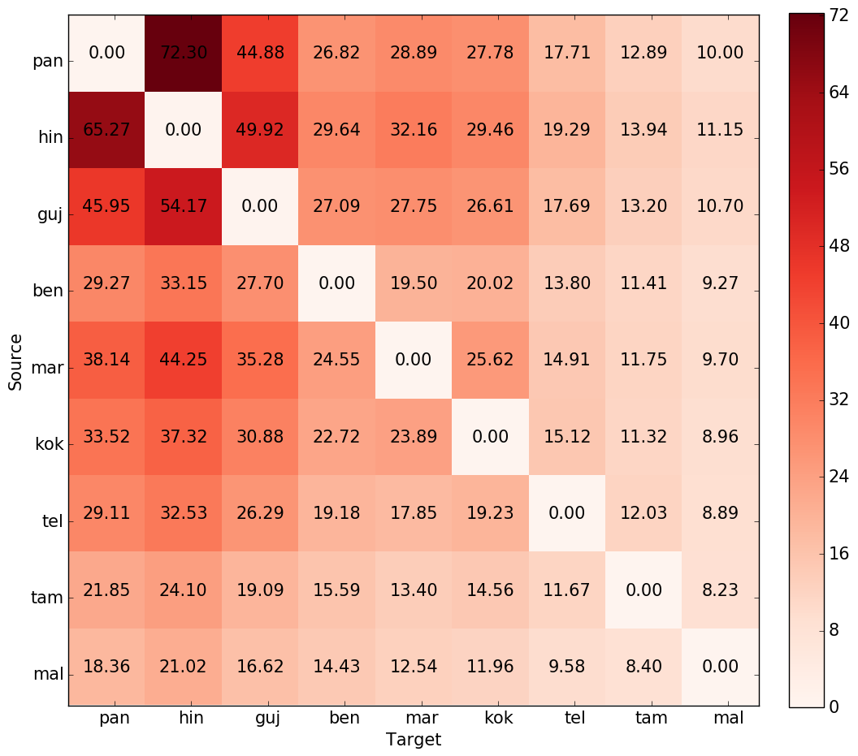
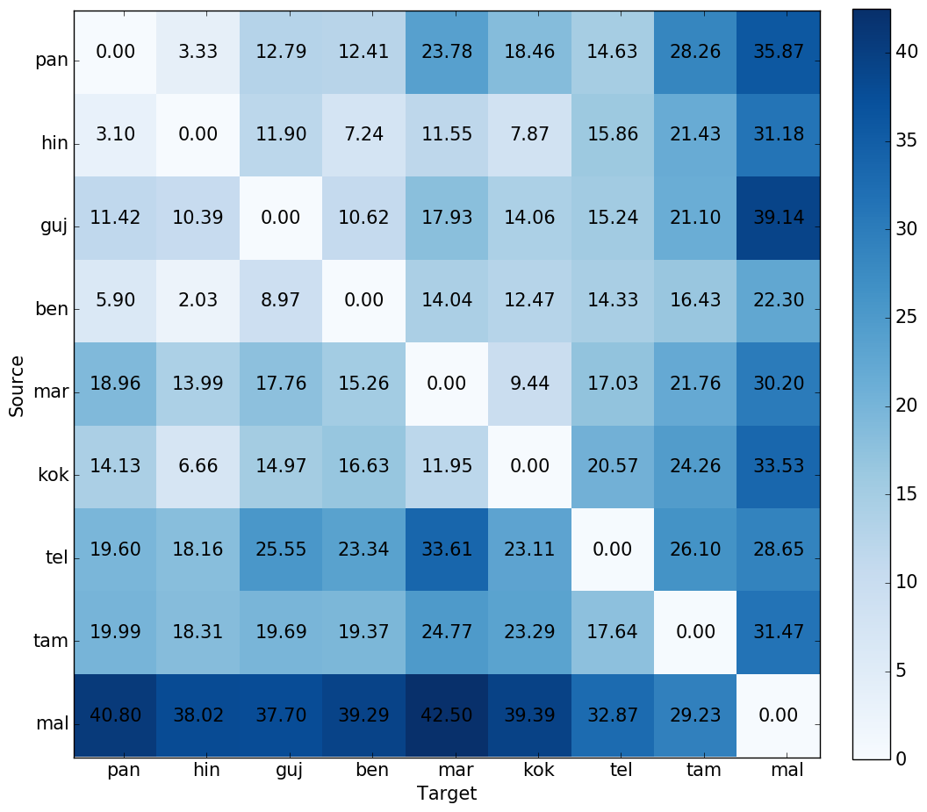
BPE level translation
BLEU scores
% improvement over word level scores

Slide 80
Factor based SMT
Ananthakrishnan Ramanathan, Hansraj Choudhary, Avishek Ghosh and Pushpak Bhattacharyya, Case markers and Morphology: Addressing the crux of the fluency problem in English-Hindi SMT, ACL-IJCNLP 2009, Singapore, August, 2009.

Slide 81
Semantic relations+Suffixes→Case Markers+inflections
I ate mangoes
I {<agt} ate {eat@past} mangoes {<obj}
I {<agt} mangoes {<obj.@pl} {eat@past}
mei_ne aam khaa_yaa

Slide 82
Our Factorization based on Koehn and Hoang (2007)

Slide 83
Experiment: Corpus Statistics

Slide 84
Results: The impact of suffix and semantic factors

Slide 85
Results: The impact of reordering and semantic relations

Slide 86
Subjective Evaluation: The impact of reordering and semantic relations

Slide 87
Cooperative NLP: Pivot Based MT
Raj Dabre, Fabien Cromiere, Sadao Kurohash and Pushpak Bhattacharyya, Leveraging Small Multilingual Corpora for SMT Using Many Pivot Languages, NAACL 2015, Denver, Colorado, USA, May 31 - June 5, 2015.

Slide 88
Triangulation
Water
(English)
Jal
(Bengali)
paanii
(Hindi)

Slide 89
L1→bridge→L2 (Wu and Wang 2009)
Resource rich and resource poor language pairs
Question-1: How about translating through a ‘bridge’?
Question-2: how to choose the bridge?

Slide 90
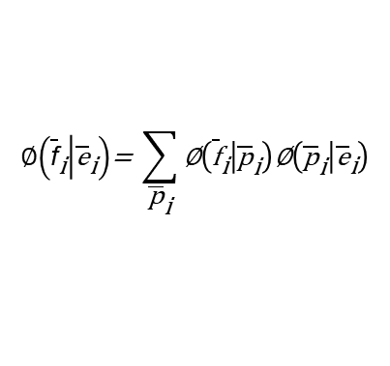
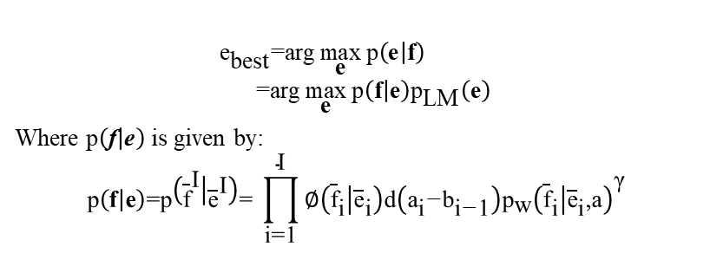
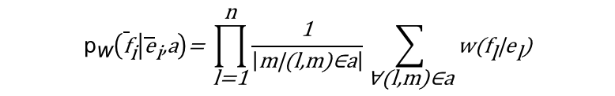
Mathematical preliminaries
$${\text{e}}_{\text{best}}\text{=}\text{arg}\underset{\text{e}}{\text{max}}{\text{p}\left(\text{e} | \text{f}\right)} \\ \text{ =}\text{arg}\underset{\text{e}}{\text{max}}{\text{p}\left(\text{f} | \text{e}\right){\text{p}}_{\text{LM}}\left(\text{e}\right)}$$
Where $\text{p}\left(\text{f} | \text{e}\right)$ is given by:
$$\text{p}\left(\text{f} | \text{e}\right)\text{=}\text{p}\left({\overline{\text{f}}}^{\text{I}} | {\overline{\text{e}}}^{\text{I}}\right)\text{= }\prod_{\text{i}\text{=1}}^{\text{I}}{\text{∅}\left({\overline{\text{f}}}_{\text{i}} | {\overline{\text{e}}}_{\text{i}}\right)\text{d}\left({\text{a}}_{\text{i}}\text{−}{\text{b}}_{\text{i}\text{−}\text{1}}\right){\text{p}}_{\text{w}}{\left({\overline{\text{f}}}_{\text{i}} | {\overline{\text{e}}}_{\text{i}}\text{,}\text{a}\right)}^{\text{γ}}}$$
$$\text{∅}\left({\overline{\text{f}}}_{\text{i}} | {\overline{\text{e}}}_{\text{i}}\right)\text{= }\sum_{{\overline{\text{p}}}_{\text{i}}}{\text{∅}\left({\overline{\text{f}}}_{\text{i}} | {\overline{\text{p}}}_{\text{i}}\right)\text{∅}\left({\overline{\text{p}}}_{\text{i}} | {\overline{\text{e}}}_{\text{i}}\right)}$$
$${\text{p}}_{\text{w}}\left({\overline{\text{f}}}_{\text{i}} | {\overline{\text{e}}}_{\text{i}}\text{,}\text{a}\right)\text{= }\prod_{\text{l}\text{=1}}^{\text{n}}{\frac{\text{1}}{\left|\text{m}\text{|(}\text{l}\text{,}\text{m}\text{)∈}\text{a}\right|}\sum_{\text{∀(}\text{l}\text{,}\text{m}\text{)∈}\text{a}}{\text{w}\text{(}{\text{f}}_{\text{l}}\text{|}{\text{e}}_{\text{l}}\text{)}}}$$

Slide 91
Triangulation approach
Important to induce language dependent components such as phrase translation probability and lexical weight
Source-Pivot Phrase Table
Pivot-Target Phrase Table
Source-Target Phrase Table
Source-Target MT System
Train and tune
Oct 19, 2014
FAN, Pushpak Bhattacharyya
48

Slide 92
Mauritian Creole (MCR) →French (FR) →English (E)
MCR and FR share vocabulary and structure
French | Creole | English
avion | Avion | aeroplane
bon | Bon | good
gaz | Gaz | gas
bref | bref | brief
pion | pion | pawn

Slide 93
Experiment on MCR→FR→E
Language pair | #Sentences | #unique words (L1-L2)
En-Fr | 2000000 | 127405- 147812
En-Cr (train + tune) | 25010 | 16294-17389
En-Cr (test) | 284 (142 short + 142 long) | 1168-1070 + 3562-3326
Fr-Cr | 18354 | 13769-13725

Slide 94
Results

Slide 95
link

Slide 96
Neural ILMT

Slide 97
NMT with embellishments (Minor revision, Journal of Machine Translation)
Phrase table injection (PTI): supplying ‘good’ phrases from SMT system as additional data source to NMT system.
Word as feature: merging word along with BPE segment to mitigate context loss.
Morph-seg-word: morpheme segmentation followed by BPE, and then merging original morpheme and word to BPE segment.
We report results for 56 systems for each of the above techniques.

Slide 98
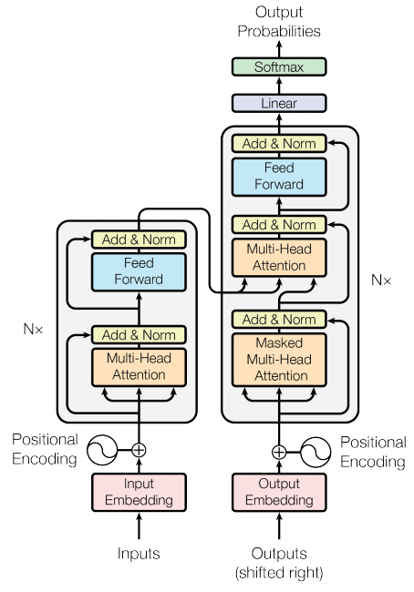
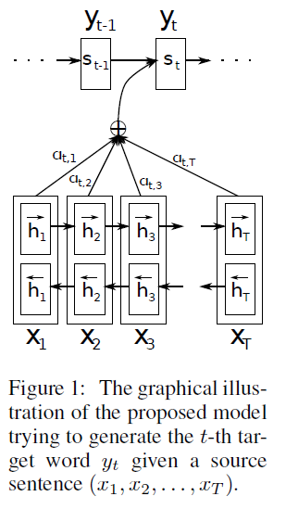
Neural MT (NMT)
BiLSTM encoder decoder ^{[3]}
Transformer ^{[8]}

Slide 99
Language independent NMT
Languages chosen:
Model: BiLSTM (details)
Dataset: ILCI 1. Tourism and health domains. Dataset size in terms of number of sentences:
Indo-Aryan (IA) family
Dravidian (DR) family
Training set | Tune set | Test set
46277 | 2000 | 500

Slide 100
En <-> {Mr, Hi} transformer output
Dataset: ILCI1
Explored lower range of merge operations.
 | BLEU w/ BPE-0k | BLEU w/ BPE-2.5k | BLEU w/ BPE-5k | SMT
En-Mr | 10.79 | 14.26 | 13.48 | 10.17
Mr-En | 19.79 | 23.82 | 24.19 | 15.87
En-Hi | 23.77 | 29.18 | 28.92 | 26.53
Hi-En | 24.22 | 31.22 | 30.39 | 28.15

Slide 101
En <-> {Mr, Hi} Dataset: ILCI1 + PMIndia
Dataset size (no. of sentences):
 | Train | Tune | Test
En-Hi | 100267 | 1068 | 4273
En-Mr | 80602 | 861 | 3445
Hi-Mr | 92981 | 1000 | 4000

Slide 102
En <-> {Mr, Hi} Baselines on ILCI1+PMIndia
 | NMT BPE-2.5k | NMT BPE-5k | NMT BPE-7.5k | SMT
En-Mr | 14.51 | 15.04 | 15.08 | 10.51
Mr-En | 23.76 | 24.15 | 24.13 | 16.6
En-Hi | 27.05 | 27.72 | 27.89 | 20.75
Hi-En | 30.96 | 31.86 | 30.45 | 24.05
Hi-Mr | 27.25 | 27.39 | - | 24.38
Mr-Hi | 37.39 | 37.75 | - | 34.31

Slide 103
En <-> {Mr, Hi} PTI results on ILCI1+PMIndia
 | BPE-2.5k | BPE-5k | BPE-7.5k | BPE-10k | Best Baseline BLEU | Improvement
En-Mr | 14.63 | 15.97 | 15.69 | - | 14.51 | +1.46
Mr-En | 23.08 | 25.22 | 25.26 | 25.03 | 24.15 | +1.11
En-Hi | 25.96 | 28.79 | 29.28 | 29.23 | 27.89 | +1.39
Hi-En | 29.94 | 33.6 | 33.93 | 34.6 | 31.86 | +2.74
Hi-Mr | - | 27.98 | 28.49 | - | 27.39 | +0.59
Mr-Hi | - | 38.94 | 39.4 | - | 37.75 | +1.65

Slide 104
En <-> {Mr, Hi} PTI + Back Translation (BT)
 | NMT BPE-5k | NMT BPE-7.5k | Improvement over PTI model
En-Mr | 16.73 | - | +0.76
Mr-En | - | 26.24 | +0.98
En-Hi | - | 30.08 | +0.8
Hi-En | - | 35.03 | +1.1

Slide 105
En <-> {Mr, Hi} PTI + Forward Translation (FT)
 | NMT BPE-5k | NMT BPE-7.5k | Improvement over PTI model
En-Mr | 16.47 | - | +0.5
Mr-En | - | 25.9 | +0.64
En-Hi | - | 29.77 | +0.49
Hi-En | - | 34.48 | +0.52

Slide 106
En <-> {Mr, Hi} PTI results
 | NMT BPE-5k | NMT BPE-7.5k | NMT BPE-10k | Best Baseline BLEU | Improvement
En-Mr | 21.05 | - | - | 20.64 | +0.41
Mr-En | 28.76 | - | - | 28.64 | +0.12
En-Hi | - | - | 34.32 | 35.17 | -0.85
Hi-En | - | - | 38.65 | 36.57 | +2.08
Hi-Mr | - | 29.09 | - | 28.67 | +0.42
Mr-Hi | - | 36.98 | - | 36.59 | +0.39

Slide 107
En-Hi-Mr NMT with embellishments (consolidated)
Approach | Hi-En | En-Hi | Hi-Mr | Mr-Hi | En-Mr | Mr-En
C: Agnostic Training | 41.9 | 37.95 | 29.1 | 37.08 | 25.34 | 32.45
D: PTI(Phrase Table Injection) | 38.65 | 34.32 | 29.09 | 36.98 | 21.05 | 28.76
E: D + Enhancement | 42.15 | 36.78 | 29.18 | 37.23 | 21.91 | 29.57
F: BERT augmented NMT | 29.74 | 25.89 | 28.64 | 34.21 | 14.98 | 18.37
G: BPE+word(pretrained BPE embeddings) | 49.65 | 43.05 | 25.40 | 31.45 | - | -
H: G+sparsemax function(instead of softmax) | 51.64 | 47.20 | 26.40 | 31.84 | 23.62 | 26.10

Slide 108
Sample outputs for En-Mr (PTI + t12)
En-src: i do know some young persons , who are active in such campaigns .
Mr-ref: असे काही युवक मला माहीत आहेत जे अशा प्रकारची मोहीम चालवतात .
OP: असे काही तरुण व्यक्ती मला माहीत आहेत जे अशा प्रकारची मोहीम चालवतात .
GT: मला अशा काही तरुण व्यक्ती माहित आहेत, जे अशा मोहिमांमध्ये सक्रिय आहेत.
Bing: अशा मोहिमांमध्ये सक्रिय असलेले काही तरुण मला माहीत आहेत.
En-src: this day marks the birth anniversary of the iron man of india , sardar vallabhbhai patel , the unifying force in bonding us as a nation
Mr-ref: हा दिवस भारताचे लोहपुरुष सरदार वल्लभभाई पटेल यांच्या जयंतीचा आहे जे देशाला ऐक्याच्या धाग्यात गुंफणारे महानायक होते .
OP: आज आपल्या देशात लोहपुरुष सरदार वल्लभभाई पटेल यांची जयंती , एक देश म्हणून एकत्र आणत आहोत .
GT: हा दिवस भारतीय लोहपुरुष सरदार वल्लभभाई पटेल या जयंतीनिमित्त आम्हाला राष्ट्र म्हणून जोडण्याचे एकत्रीकरण
Bing: या दिवशी सरदार वल्लभभाई पटेल या लोहपुरुषाची जयंती आहे. (incomplete)

Slide 109
Hindi-Marathi Examples
Hi: यदि श्वास प्रणालिका में सूजन आ जाये तब भी रक्त मुँह के रास्ते बाहर आने लगता है ।
Reference Mr: जर श्वासनलिकेला सूज आली तरीही रक्त तोंडावाटे बाहेर येऊ लागते.
Model Op: जर श्वासनलिकेत सूज आली तरीदेखील रक्त तोंडावाटे बाहेर येऊ लागते .
Google: जरी श्वसन प्रणालीमध्ये सूज येत असेल तर, तोंडातून रक्त देखील बाहेर येते.
Hi: जब यह हिस्से तीव्रता से घटते हैं तो पेट थोड़ा भूखा रहता है और मस्तिष्क को भूख के संकेत देता है ।
Reference Mr: जेव्हा हे भाग वेगाना कमी होतात, तेव्हा पोट थोडेसे भूके राहतात.
Model Op: जेव्हा हा भाग तीव्रतेने कमी होत असतो तेव्हा पोट थोडे उपाशी राहतो आणि मस्तिष्काला भूकेचा संकेत देतो .
Google: जेव्हा हे भाग झपाट्याने कमी होतात तेव्हा पोट किंचित भूक राहते आणि मेंदूला उपासमारीचे संकेत देते.

Slide 110
Examples from Covid Domain
Hi: यदि स्वास्थ्य अनुमति देता है, तो नियमित रूप से घरेलू काम किया जाना चाहिए। पेशेवर काम को श्रेणीबद्ध तरीके से फिर से शुरू किया जाना है।
Model Op: जर आरोग्य परवानगी देवून माकडून तर नियमितपणे घरगुती काम केले जाणे अवर्णनीय निर्धाराला कठीण पद्धतीने पुन्हा सुरू केले जाणे
Google: आरोग्यास परवानगी मिळाल्यास घरातील कामे नियमितपणे करावीत. व्यावसायिक काम श्रेणीरित्या पुन्हा सुरू करावे लागेल.
Hi: रोज सुबह या शाम आराम से चलना जितना कि सहन किया जा सके ।
Model Op: रोज सकाळी किंवा संध्याकाळी आरामात चालणे जेवढे सहन केले जाऊ शकते .
Google: जितके सहन केले जाऊ शकते तितके दररोज सकाळी किंवा संध्याकाळी आरामात चालणे.

Slide 111
Examples from Programming Domain
Hi: दूसरी ओर एक व्हाइल लूप आम तौर पर इस्तेमाल किया जाता है जब आपको अग्रिम से नहीं पता होता है।
Model Op: दुसर्या बाजूला एक अपायकारक अनावश्यक वापर केला जातो जेव्हा तुम्हाला लगेच कळत नाही .
Google: दुसरीकडे जेव्हा आपल्याला आगाऊ माहिती नसते तेव्हा पांढरा पळवाट सामान्यत: वापरला जातो.
Hi: अब हम यह अंत से शुरू कर रहे हैं और केवल पहला कारक रख रहे है कि हम तो , तो हमने जो इस उदाहरण में देखा एक नए प्रकार का लूप है ।
Model Op: आता आम्ही हा शेवटपासून सुरू करत आहोत आणि केवळ पहिले कारण आहे की आपण तर या उदाहरणामध्ये पाहिले , एक नवीन प्रकारचा स्पष्ट आहे .
Google: आता आपण या टोकापासून सुरूवात करीत आहोत आणि फक्त पहिला घटक ठेवणे म्हणजे आपण, नंतर या उदाहरणात जे पाहिले ते एक नवीन प्रकारचे लूप आहे.

Slide 112
Disfluency Correction in the context of Speech to Speech MT (under review for EACL 2021)
Pair: Disfluent English - Fluent English (Switchboard corpus)
Domain: includes telephone conversations between strangers on specific topics.
Type | Set | Disfluent Sentences | Fluent Sentences
Non Parallel | Train | 55,482 | 55,482
Parallel | Dev | 11,889 | 11,889
 | Test | 11,889 | 11,889

Slide 113
Results
 | Model | Validation | Test
Supervised | Sequence to Sequence (Bi-LSTM) | 87.23 | 88.08
 | BART | 89.27 | 90.08
Unsupervised | Noise Induction (Transformer) | 65.17 | 53.78
 | Style Transfer (Bi-LSTM) | 61.26 | 62.77
 | Style Transfer (Transformer) | 78.72 | 79.39
Semi-Supervised | Style Transfer (Transformer) | 84.1 | 85.28
Semi-Supervised: Amount of parallel data = 554 sentences (1% of train set)

Slide 114
Example Output
Type | Disfluent | BART | Seq-to-Seq | US(Bi-LSTM) | US( Transformer) | SS (Transformer) | Fluent
discourse, filler | so uh been a different turn | been a different turn | been a different turn | been a different turn | been a different turn | been a different turn | been a different turn
conjunction, repetition | but i i i find this whole | i find this whole | i find this whole | anyway i find it all | i find this whole | i find this whole | i find this whole
restart | it’s you’re you’re taking words and developing a picture in your mind | you’re taking words and developing a picture in your mind | you’re taking words and developing a picture in your mind | it’s you’re taking chicken and tobacco words in a mind | it’s taking words and developing and a picture in your mind | it’s taking words and developing and a picture in your mind | you’re taking words and developing a picture in your mind
US: Unsupervised, SS: Semi-supervised

Slide 115
Summary
MT Paradigms
Data Driven MT: SMT and NMT
Tricks of Resource Mitigation
Unsupervised NMT
Experience of IL-NMT

Slide 116
Summary on resource mitigation tricks
Several techniques explored and demonstrated their efficacy.
Phrase Table Injection, has great potential to boost BLEU scores, particularly when Dravidian languages are involved.
Harnessing monolingual data with back translation, forward translation is advantageous.
Enhancements like morph and word feature injection

Slide 117
Final Message
“NLP is a task in Trade Off”
e.g., Not too much of subwords or cooperation
(beware of ‘ambiguity insertion’),
not too little
(beware of ‘sparsity’) !!

Slide 118
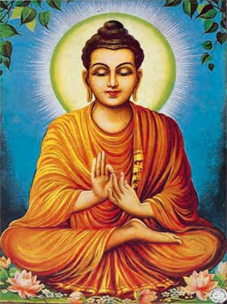
“The middle path is the golden one”- Buddha

Slide 119
URLS
http://www.cse.iitb.ac.in/~pb
http://www.cfilt.iitb.ac.in

Slide 120
Thank You

Slide 121
Why is Unsupervised NMT needed?
Diptesh Kanojia

Slide 122
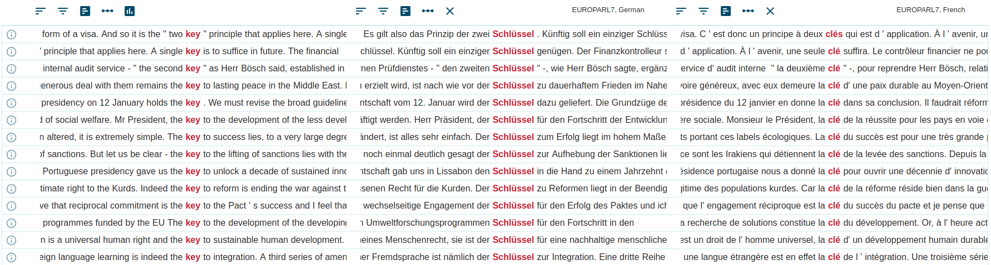


Unsupervised NMT - Why?
Supervised NMT
Parallel Corpus
Monolingual Corpus
Manual Translations
Cognitive Load
Notes:
Domain specificity

Slide 123
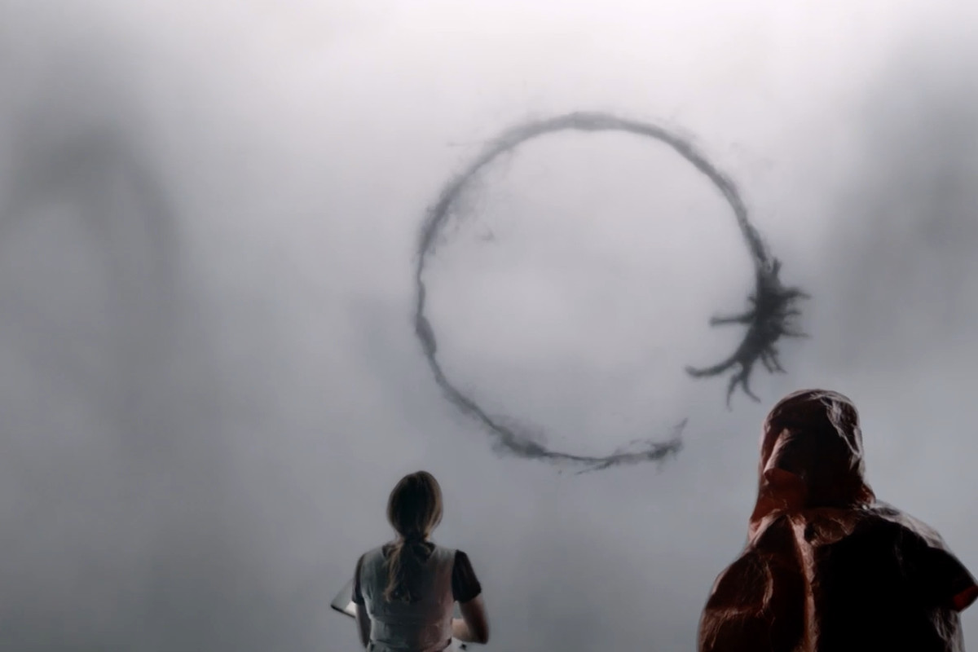
“Unsupervised” NMT
No parallel corpus
However, the requirement is:
Large monolingual corpus
Cross-lingual Word Embeddings
Low-resource languages
Image Source: Paramount Pictures

Slide 124
Resource Constraints
Lack of resources for NLP tasks.
Low resource languages.
Indian Languages including Sanskrit.
Hebrew, Greek, and Latin.
Obscure Languages such as Sentinelese (North Sentinel Island, Indian Ocean), Ugaritic, etc.
Monolingual corpus may be available.

Slide 125
Resource Generation/Building
Parallel word mappings can be generated.
Unsupervised Embedding mappings (similar script).
Word mappings can also be created manually.
For language written in different scripts, but human supervision is needed.
Word representations form the crux of most NLP tasks.

Slide 126
Foundations
Cross-lingual embeddings
Denoising Autoencoder
Back-translation

Slide 127
Word Representation for Humans
In humans, the acquisition of information and creation of mental representations occurs in a two-step process. (Ramos et. al., 2014)
Sufficiently complex brain structure is necessary to establishing internal states capable to co-vary with external events.
The validity or meaning of these representations must be gradually achieved by confronting them with the environment.

Slide 128
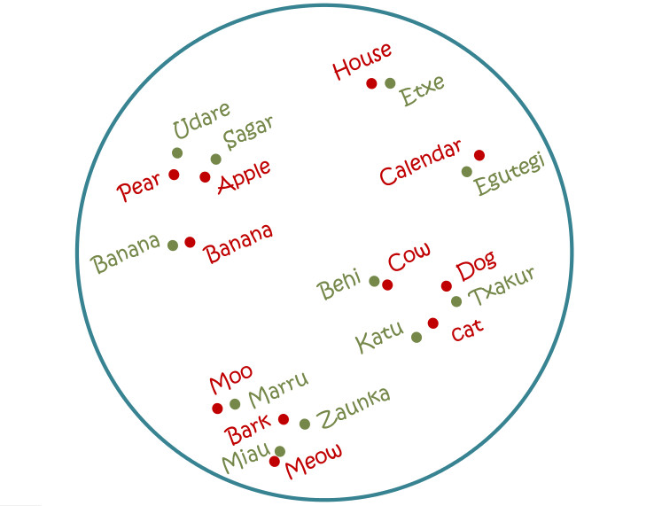
Cross-lingual Word Embeddings
The geometric relations that hold between words are similar across languages*.
For instance, numbers and animals in English show a similar (isomorphic) geometric structure as their Spanish counterparts.
The vector space of a source languages can be transformed to the vector space of the target language t by learning a linear projection with a transformation matrix W ^{s→t}.
Image source- www.mikelartetxe.com
Notes:
*Isomorphic properties of relations between words is still an assumption. (10 20 seconds)

Slide 129
Cross-lingual embeddings: Approaches
Cross-lingual embeddings
Mapping based
Joint loss based
Pseudo multi-lingual corpora based
Vecmap
Joint - Replace
Random Translation Replacement
MUSE
Joint Matrix Factorization
Multilingual Cluster
GeoMM
RCSLS

Slide 130
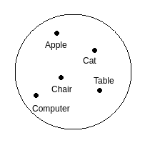
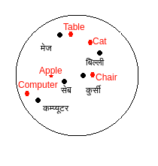
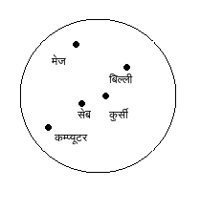
Cross-lingual embeddings: Mapping based
Task is to learn W_{X} and W_{Y} (the transformation matrices)
X, Y are monolingual embedding spaces
X
XW_{X}
YW_{Y}
Y

Slide 131

MUSE
Given, target Vector Y and source Vector X
Learns Mapping Y=XW.
Trains a discriminator to tell whether two vectors are from the same language.
Also, a generator to map the vectors from one language into each other.
Conneau, Alexis, Guillaume Lample, Marc'Aurelio Ranzato, Ludovic Denoyer, and Hervé Jégou. "Word translation without parallel data." arXiv preprint arXiv:1710.04087 (2017).
Notes:
Given target vector Y and source vector X, MUSE learns a mapping Y = XW between the two spaces.
It trains a discriminator to tell whether two vectors are from the same language, and a generator to map the vectors from one language into each other. It does this in such a way that the distribution of vectors in each of the two languages is the same.
The discriminator and the generator are adversaries – they each train to try to beat the other.

Slide 132
VecMap (Artexe et al. 2018)
Embedding Normalization
Unsupervised Initialization
Self Learning
Symmetric Reweighting
Embeddings Normalization
Length normalization + Mean centering + Length normalization
Unsupervised initialization
Assume both spaces are isometric
Nearest neighbor retrieval on XX^{T} and YY^{T}
Self training
Compute the optimal orthogonal mapping by maximizing the similarity for the current dictionary D
Compute the dictionary over the similarity matrix of the mapped embeddings
Symmetric weighting to induce good dictionary
W_{X} = US^{1/2} , W_{Y} = VS^{1/2}
Artetxe Mikel, Gorka Labaka, and Eneko Agirre. "A robust self-learning method for fully unsupervised cross-lingual mappings of word embeddings." ACL 2018.

Slide 133
Joint training + Cross-lingual alignment (Wang et al 2019)
Joint initialization
Joint training using monolingual embedding training algorithm using combined corpus
Vocabulary reallocation
Create source, target and common vocabulary
Alignment refinement
Mapping based algorithm for align source and target to the same space
Wang Z, Xie J, Xu R, Yang Y, Neubig G, Carbonell JG (2019) Cross-lingual alignment vs joint training: A comparative study and a simple unified framework. In: International Conference on Learning Representations

Slide 134
Foundations
Cross-lingual embeddings
Denoising Autoencoder
Back-translation

Slide 135
Autoencoder
Input layer
Output layer
Representation learning
Neural network to learn reconstruction of the data
Optimize Reconstruction Error
Balance between
Accurately build a reconstruction
Handle inputs such that the model doesn’t learn to copy the data
x₁
x₁
Hidden layer
x₂
h₁
x₂
x₃
h₂
x₃
x₄
h₃
x₄
x₅
x₅

Slide 136
Denoising auto-encoder
Learn to generate original sentence from a noisy version of it
Eliminates the learning of identity function
x₁
nx₁
x₁
x₂
nx₂
h₁
x₂
x₃
nx₃
h₂
x₃
x₄
nx₄
h₃
x₄
x₅
nx₅
x₅
Corrupted data

Slide 137
Denoising auto-encoder
Noisy sentence
Encoder representation is the representation for noisy sentence
Decoder tries to generate the original sentence from the encoder representation of the noisy sentence
A sentence can be corrupted using different types of noise
Swapping of words
Removal of words
Replacement of words with other words
Encoder
Decoder
Original sentence

Slide 138
Foundations
Cross-lingual embeddings
Denoising Autoencoder
Back-translation

Slide 139
Back-Translation
Utilize monolingual data of target language
Generate pseudo parallel data using MT system in opposite direction (target->source)
Generation of pseudo parallel sentences
Monolingual data of L1
MT system (L2>-L1)
Translated sentences
Train MT system (L1->L2) using a combination of parallel and generated synthetic data both
Sennrich, Rico, Barry Haddow, and Alexandra Birch. "Improving Neural Machine Translation Models with Monolingual Data." In Proceedings of the 54th Annual Meeting of the Association for Computational Linguistics (Volume 1: Long Papers), pp. 86-96. 2016.

Slide 140
Iterative Back-Translation
D=Parallel corpus
SD=Synthetic data
Train MT_{L2->L1} using D
D = D U SD
Generate synthetic data(SD) for MT_{L1->L2} using MT_{L2->L1}
Generate synthetic data(SD) for MT_{L2->L1} using MT_{L1->L2}
D = D U SD
Train MT_{L1->L2} using D

Slide 141

Iterative Back-Translation
Beneficial for Low resource languages also
Image source: Hoang, Vu Cong Duy, Philipp Koehn, Gholamreza Haffari, and Trevor Cohn. "Iterative back-translation for neural machine translation." In Proceedings of the 2nd Workshop on Neural Machine Translation and Generation, pp. 18-24. 2018.

Slide 142
UMT Approaches
Tamali Banerjee
Unsupervised NMT
GAN for UNMT
Unsupervised SMT
Hybrid UMT

Slide 143
Introduction
List of papers
Mikel Artetxe, Gorka Labaka, Eneko Agirre, and Kyunghyun Cho. 2018. Unsupervised Neural Machine Translation. In Proceedings of the Sixth International Conference on Learning Representations (ICLR 2018).
G. Lample, A. Conneau, L. Denoyer, MA. Ranzato. 2018. Unsupervised Machine Translation With Monolingual Data Only. In Proceedings of the Sixth International Conference on Learning Representations (ICLR 2018).
In ICLR 2018, two concurrent papers showed that it is possible to train an NMT system without using any parallel data.

Slide 144
Components of U-NMT
Bi-lingual embedding: It projects word embeddings of both languages in the same embedding space.
Language modeling: It helps the model to encode and generate sentences.
Through initialization of the translation models.
Through iterative training.
Iterative back-translation: It bridges the gap between encoder sentence representation in source and target languages.

Slide 145


Effect of Back-translation
L1-L2 pretraining L1
L1-L2 pretraining L2
L1-L2 finetuning L1
L1-L2 finetuning L2
Before Back-translation
After Back-translation
Image credit: Rudra and Jyotsana

Slide 146

Architecture
Bi-lingual embedding layer
Encoder-Decoder architecture
Dual structure
Sharing of modules
Image source: Mikel Artetxe, Gorka Labaka, Eneko Agirre, and Kyunghyun Cho. 2018. Unsupervised Neural Machine Translation. In Proceedings of the Sixth International Conference on Learning Representations (ICLR 2018).

Slide 147

Training Procedure
DAE_{src}: Denoising of source sentences; DAE_{trg}: Denoising of target sentences;
BTS_{src}: Back-translation with shuffled source sentences; BTS_{trg}: Back-translation with shuffled target sentences;
n : total number of iteration till it reaches stopping criterion.

Slide 148

U-NMT: Denoising of source sentences
Trainable unit
Input src sentence
confidential data had been passed to the team
Input src sentence
Noisy src sentence
confidential data had been passed to the team
confidential had data been passed to team the
Noise adding algorithm
Source: Mikel Artetxe, Gorka Labaka, Eneko Agirre, and Kyunghyun Cho. 2018. Unsupervised Neural Machine Translation. In Proceedings of the Sixth International Conference on Learning Representations (ICLR 2018).

Slide 149
U-NMT: Denoising of target sentences
Trainable unit
Input trg sentence
Noisy trg sentence
le disque comprendra aussi deux chansons en italien
comprendra le aussi deux disque chansons en italien
Noise adding algorithm
Input trg sentence
le disque comprendra aussi deux chansons en italien
Source: Mikel Artetxe, Gorka Labaka, Eneko Agirre, and Kyunghyun Cho. 2018. Unsupervised Neural Machine Translation. In Proceedings of the Sixth International Conference on Learning Representations (ICLR 2018).

Slide 150
U-NMT: Back-translation Corpus Construction (source to target)
Non-trainable
Input real src sentence
confidential data has been passed to the team
confidential data has been passed to the team
Noise adding algorithm
Output in trg language (synthetic sentence)
des données confidentielles avaient été transmises à l’équipe
Source: Mikel Artetxe, Gorka Labaka, Eneko Agirre, and Kyunghyun Cho. 2018. Unsupervised Neural Machine Translation. In Proceedings of the Sixth International Conference on Learning Representations (ICLR 2018).

Slide 151
U-NMT: Back-translation Corpus Construction (target to source)
Non-trainable
Output in src language (synthetic sentence)
the disc will also include two songs in Italian
Input real trg sentence
le disque comprendra aussi deux chansons en italien
le disque comprendra aussi deux chansons en italien
Noise adding algorithm
Source: Mikel Artetxe, Gorka Labaka, Eneko Agirre, and Kyunghyun Cho. 2018. Unsupervised Neural Machine Translation. In Proceedings of the Sixth International Conference on Learning Representations (ICLR 2018).

Slide 152
U-NMT: Training with Back-translated data (source to target)
Trainable unit
Input synthetic sentence
In src language
Noisy input sentence
the disc will also include two songs in Italian
the will also disc two include songs italian in
Noise adding algorithm
Output real sentence
in trg language
le disque comprendra aussi deux chansons en italien
Source: Mikel Artetxe, Gorka Labaka, Eneko Agirre, and Kyunghyun Cho. 2018. Unsupervised Neural Machine Translation. In Proceedings of the Sixth International Conference on Learning Representations (ICLR 2018).

Slide 153
U-NMT: Training with Back-translated data (target to source)
Trainable unit
Output real sentence
in src language
confidential data had been passed to the team
Input synthetic sentence
In tgt language
Noisy input sentence
des données confidentielles avaient été transmises à l’équipe
données avaient des été confidentielles transmises l’équipe à
Noise adding algorithm
Source: Mikel Artetxe, Gorka Labaka, Eneko Agirre, and Kyunghyun Cho. 2018. Unsupervised Neural Machine Translation. In Proceedings of the Sixth International Conference on Learning Representations (ICLR 2018).

Slide 154
Comparison between two approaches
L1 Decoder
L2 Decoder
Shared Decoder
Path for L1
Path for L2
Shared path
Shared Encoder
Shared Encoder
Artexte et al.
Lample et al.
Decoders are non-shared for Artexte et al. and shared for Lample et al.
Lample et al. initialises training with word-by-word translation. [Next few slides]
Lample et al. uses a language discriminator for encoder representation. It challenges the language invariance nature of encoder representations. [Next subsection]

Slide 155
Training with word-by-word translation
Generation of word-translated sentence
सुरक्षित
(surakshit)
Unsupervised dictionary induction
સલામત
(salāmata)
घर पर सुरक्षित रहें
(ghar par surakshit rahen)
ઘર ચાલુ સલામત રહેવું
(Ghar Cālu salāmata rahēvuṁ)
Unsupervised dictionary induction

Slide 156
Training with word-by-word translation
घर पर सुरक्षित रहें
(ghar par surakshit rahen)
ઘર ચાલુ સલામત રહેવું
(Ghar Cālu salāmata rahēvuṁ)
Unsupervised dictionary induction
Generation of synthetic parallel corpus
Hindi monolingual corpus
Synthetic Gujarati translations
Unsupervised dictionary induction

Slide 157
Training with word-by-word translation
घर पर सुरक्षित रहें
(ghar par surakshit rahen)
ઘર ચાલુ સલામત રહેવું
(Ghar Cālu salāmata rahēvuṁ)
Unsupervised dictionary induction
Can we use this synthetic parallel corpus to train a NMT model?
Hindi monolingual corpus
Synthetic Gujarati translations
Synthetic Gujarati - Gold Hindi parallel corpus
Unsupervised dictionary induction

Slide 158
Training with word-by-word translation
घर पर सुरक्षित रहें
(ghar par surakshit rahen)
ઘર ચાલુ સલામત રહેવું
(Ghar Cālu salāmata rahēvuṁ)
Unsupervised dictionary induction
Generation of sentence translation
घर पर सुरक्षित रहें
(ghar par surakshit rahen)
ઘરે સલામત રહેવું
(Gharē salāmata rahēvuṁ)
UNMT

Slide 159
Effect of DAE and BT
Author |  | Approach | Fr → En | En→ Fr | De → En | En → De
Artexte et al. (tested on WMT14) |  | Emb. nearest neighbour | 9.98 | 6.25 | 7.07 | 4.39
 |  | Denoising | 7.28 | 5.33 | 3.64 | 2.40
 |  | Denoising + Back-translation | 15.56 | 15.13 | 10.21 | 6.55
Lample et al. (tested on WMT14 en-fr and WMT16 en-de) |  | Emb. nearest neighbour | 10.09 | 6.28 | 10.77 | 7.06
 |  | Word2word pretraining + Denoising + Back-translation | 15.31 | 15.05 | 13.33 | 9.64
Mikel Artetxe, Gorka Labaka, Eneko Agirre, and Kyunghyun Cho. 2018. Unsupervised Neural Machine Translation. In Proceedings of the Sixth International Conference on Learning Representations (ICLR 2018).
G. Lample, A. Conneau, L. Denoyer, MA. Ranzato. 2018. Unsupervised Machine Translation With Monolingual Data Only. In Proceedings of the Sixth International Conference on Learning Representations (ICLR 2018).

Slide 160
UMT Approaches
Unsupervised NMT
GAN for UNMT
Unsupervised SMT
Hybrid UMT

Slide 161
Introduction
List of papers
Yang, Z., Chen, W., Wang, F. and Xu, B., 2018, July. Unsupervised Neural Machine Translation with Weight Sharing. In Proceedings of the 56th Annual Meeting of the Association for Computational Linguistics (Volume 1: Long Papers) (pp. 46-55).
Use GAN to enhance the language invariance.
Sharing of the whole model faces difficulty in keeping the diversity of languages.
Share module partially

Slide 162

Generative Adversarial Networks (GAN)
GANs are a clever way of training with two sub-models:
Generator model that we train to generate new examples,
Discriminator model that tries to classify examples as either real.
In case of UNMT,
Shared encoder is the generator.
An extra discriminator module is attached with it to discriminate encoder representations w.r.t. language.
GAN: Two neural networks (a generative network and a discriminative network) compete with each other to become more accurate in their predictions.

Slide 163
Different parameter sharing strategies
Shared Decoder
L1 Decoder
L2 Decoder
Shared Encoder
Shared Encoder
Shared Decoder
L1 Decoder
L2 Decoder
L1 Encoder
L2 Encoder
Path for L1
Path for L2
Shared path
L1 Encoder
L2 Encoder

Slide 164
Language specific Encoder-Decoder
L1 Decoder
L2 Decoder
❌
L1 Encoder
L2 Encoder
Path for L1
Path for L2
Shared path

Slide 165
Language specific Encoder-Decoder
How to share Latent space?
L1 Decoder
L2 Decoder
✅
Latent space
L1 Encoder
L2 Encoder
Path for L1
Path for L2
Shared path

Slide 166
Parameter sharing
output
output
Layer 4 of lang1
Layer 4 of lang2
Layer 3 of lang1
Layer 3 of lang2
Layer 2 of lang1
Layer 2 of lang2
Layer 1 of lang1
Layer 1 of lang2
chocolate in the box
बॉक्स में चॉकलेट

Slide 167
Parameter sharing
output
Shared layer 4
Layer 3 of lang1
Layer 3 of lang2
Layer 2 of lang1
Layer 2 of lang2
Layer 1 of lang1
Layer 1 of lang2
chocolate in the box
बॉक्स में चॉकलेट

Slide 168
Parameter sharing
output
Shared layer 4
Shared layer 3
Layer 2 of lang1
Layer 2 of lang2
Layer 1 of lang1
Layer 1 of lang2
chocolate in the box
बॉक्स में चॉकलेट

Slide 169
Parameter sharing
output
Shared layer 4
Shared layer 3
Shared layer 2
Layer 1 of lang1
Layer 1 of lang2
chocolate in the box
बॉक्स में चॉकलेट

Slide 170
Parameter sharing
output
Shared layer 4
Shared layer 3
Shared layer 2
Shared layer 1
chocolate in the box
बॉक्स में चॉकलेट

Slide 171
Architecture with weight-sharing layers
chocolate in the box
बॉक्स में चॉकलेट
Layer 4 of lang1
Layer 4 of lang2
Layer 3 of lang1
Layer 3 of lang2
Layer 2 of lang1
Layer 2 of lang2
Shared layer 1
Latent space
Shared layer 4
Layer 3 of lang1
Layer 3 of lang2
Layer 2 of lang1
Layer 2 of lang2
Layer 1 of lang1
Layer 1 of lang2
chocolate in the box
बॉक्स में चॉकलेट

Slide 172

Number of weight-sharing layers vs. BLEU
In this approach, sharing only 1 layer gives best BLEU scores.
When sharing is more than 1 layer, the BLEU scores drop.
This drop is more in case of distant language-pairs when compared to drop in close language-pairs.
Image source: Yang, Z., Chen, W., Wang, F. and Xu, B., 2018, July. Unsupervised Neural Machine Translation with Weight Sharing. In Proceedings of the 56th Annual Meeting of the Association for Computational Linguistics (Volume 1: Long Papers) (pp. 46-55).

Slide 173

Weight sharing in UNMT
Weight sharing UNMT architecture with GAN
When sharing is less, we need GAN to ensure input language invariance of encoder representations and outputs.
Two types of GAN are used here.
Local GAN D_{L} to ensure input language invariance of encoder representations.
Global GAN D_{g1} and D_{g2} to ensure input language invariance of output sentences.
Image source: Yang, Z., Chen, W., Wang, F. and Xu, B., 2018, July. Unsupervised Neural Machine Translation with Weight Sharing. In Proceedings of the 56th Annual Meeting of the Association for Computational Linguistics (Volume 1: Long Papers) (pp. 46-55).

Slide 174

Results
Yang, Z., Chen, W., Wang, F. and Xu, B., 2018, July. Unsupervised Neural Machine Translation with Weight Sharing. In Proceedings of the 56th Annual Meeting of the Association for Computational Linguistics (Volume 1: Long Papers) (pp. 46-55).

Slide 175
UMT Approaches
Unsupervised NMT
GAN for UNMT
Unsupervised SMT
Hybrid UMT

Slide 176
Introduction
List of papers
Artetxe, M., Labaka, G. and Agirre, E., 2018. Unsupervised Statistical Machine Translation. In Proceedings of the 2018 Conference on Empirical Methods in Natural Language Processing (pp. 3632-3642).
Lample, G., Ott, M., Conneau, A., Denoyer, L. and Ranzato, M.A., 2018. Phrase-Based & Neural Unsupervised Machine Translation. In Proceedings of the 2018 Conference on Empirical Methods in Natural Language Processing (pp. 5039-5049).
Artetxe, M., Labaka, G. and Agirre, E., 2019, July. An Effective Approach to Unsupervised Machine Translation. In Proceedings of the 57th Annual Meeting of the Association for Computational Linguistics (pp. 194-203).
Components of SMT:
Phrase table
Language model
Reordering model
Word/phrase penalty
Tuning
Challenges-
Phrase table induction without parallel data.
Unsupervised Tuning
Improvement-
Iterative refinement
Subword information

Slide 177
Phrase table induction in an unsupervised way
Get n-gram embedding using skip-gram with negative samples.

Slide 178
Phrase table induction in an unsupervised way
Get n-gram embedding using skip-gram with negative samples.
Window
Two kinds of tests are available for COVID-19
C
W
Update
Update

Slide 179
Phrase table induction in an unsupervised way
Get n-gram embedding using skip-gram with negative samples.
Two kinds of tests are available for COVID-19
W
C
Update
Update

Slide 180
Phrase table induction in an unsupervised way
Get n-gram embedding using skip-gram with negative samples.
Two kinds of tests are available for COVID-19
W
C
Update
Update

Slide 181
Phrase table induction in an unsupervised way
Get n-gram embedding using skip-gram with negative samples.
Two kinds of tests are available for COVID-19
W
C
Update
Update

Slide 182
Phrase table induction in an unsupervised way
Get n-gram embedding using skip-gram with negative samples.
Two kinds of tests are available for COVID-19
W
C
Update
Update

Slide 183
Phrase table induction in an unsupervised way
Get n-gram embedding using skip-gram with negative samples.
Two kinds of tests are available for COVID-19
P
C
Update
Update

Slide 184
Phrase table induction in an unsupervised way
Get n-gram embedding using skip-gram with negative samples.
Two kinds of tests are available for COVID-19
P
C
Update
Update

Slide 185
Phrase table induction in an unsupervised way
Get n-gram embedding using skip-gram with negative samples.
Two kinds of tests are available for COVID-19
P
C
Update
Update

Slide 186

Phrase table induction in an unsupervised way
Get cross-lingual n-gram embedding.
Calculate Phrase-translation probabilities.
Limit the translation candidates for each source phrase to its 100 nearest neighbors in the target language.
Apply the softmax function over the cosine similarities of their respective embeddings.

Slide 187
Unsupervised Tuning
Tuning with synthetic data.
Generate a synthetic parallel corpus.
Apply MERT tuning over it iteratively repeating the process in both directions.
Sentence of L1
Translation in L2
U-SMT
Sentence in L1
Sentence in L2
Pseudo parallel data
Unsupervised optimization objective:
Cyclic loss: The translation of translation of a sentence should be close to the original text.
LM loss: We want a fluent sentence in the target language.
L = L_{cycle}(E) +L_{cycle}(F) +L_{lm}(E) +L_{lm}(F)

Slide 188
Iterative refinement
Generate a synthetic parallel corpus by translating the monolingual corpus with the initial system L1→L2, and train and tune SMT system L2→L1.
To accelerate the experiments, use a random subset of 2 million sentences from each monolingual corpus for training.
Reuse the original language model, which is trained in the full corpus.
The process can be repeated iteratively until some convergence criterion is met.

Slide 189

Adding subword information
We want to favor phrase translation candidates that are similar at the character level.
Additional weights are added to initial phrase-table.
Unlike lexical weightings it use a character-level similarity function instead of word translation probabilities.

Slide 190

Results
Artetxe, M., Labaka, G. and Agirre, E., 2018. Unsupervised Statistical Machine Translation. In Proceedings of the 2018 Conference on Empirical Methods in Natural Language Processing (pp. 3632-3642).

Slide 191
UMT Approaches
Unsupervised NMT
GAN for UNMT
Unsupervised SMT
Hybrid UMT

Slide 192
Introduction
List of papers
Lample, G., Ott, M., Conneau, A., Denoyer, L. and Ranzato, M.A., 2018. Phrase-Based & Neural Unsupervised Machine Translation. In Proceedings of the 2018 Conference on Empirical Methods in Natural Language Processing (pp. 5039-5049).
Artetxe, M., Labaka, G. and Agirre, E., 2019, July. An Effective Approach to Unsupervised Machine Translation. In Proceedings of the 57th Annual Meeting of the Association for Computational Linguistics (pp. 194-203).
We can combine UNMT and USMT in two ways.
USMT followed by UNMT.
UNMT followed by USMT.

Slide 193
USMT followed by UNMT Vs. UNMT followed by USMT
USMT followed by UNMT wins.
USMT followed by UNMT:
Generate pseudo parallel data with USMT.
Initialise UNMT system with the pseudo parallel data.
UNMT followed by USMT:
Generate pseudo parallel data with UNMT.
Initialise USMT system with the pseudo parallel data.
WMT 14/16 | En→Fr | Fr→En | En→De | De→En
NMT + PBSMT | 27.1 | 26.3 | 17.5 | 22.1
PBSMT + NMT | 27.6 | 27.7 | 20.2 | 25.2
Lample, G., Ott, M., Conneau, A., Denoyer, L. and Ranzato, M.A., 2018. Phrase-Based & Neural Unsupervised Machine Translation. In Proceedings of the 2018 Conference on Empirical Methods in Natural Language Processing (pp. 5039-5049).

Slide 194
Pre-training approaches for Unsupervised NMT

Slide 195
XLM, CMLM, MASS, BART, mBART

Slide 196
XLM
Cross-lingual Language Model Pretraining, Advances in Neural Information Processing Systems. 2019.
Cross-lingual Language Modelling Pre-Training

Slide 197
Typical Deep Learning Module
Output
Decoder
Embedding Space (Randomly Initialized Lookup Table)
Encoder
bank
rain
Lookup Table
finance
humidity
weather
money
Input Symbol (Characters, Words, Phrases, Sentences…)

Slide 198
Typical Deep Learning Module
Output
Decoder
Embedding Space (Initialized with Pre-Trained Embeddings)
(Bengio et.al 2003, Collobert and Weston 2011, Mikolov et.al 2013)
Encoder
money
bank
finance
weather
Lookup Table
(Initialized Pre-trained embeddings)
rain
humidity
Input Symbol (Characters, Words, Phrases, Sentences…)

Slide 199
Typical Deep Learning Module
Output
Decoder
I went to the market
I went to the grocery store
Encoder
India won the match
India defeated Australia
Lookup Table
(Initialized Pre-trained embeddings)
Pre-train Encoder?
Input Symbol (Characters, Words, Phrases, Sentences…)

Slide 200
General Framework
L1 Monolingual Corpus
Language Model Pre-Training
L2 Monolingual Corpus
Unsupervised NMT Fine Tuning
Pre-Training
Fine-Tuning

Slide 201

XLM Pre-Training

Slide 202
XLM Fine Tuning
Perform fine-tuning using
Iterative back-translation
Denoising auto-encoding
Alternate between the two objective
Denoising auto-encoding helps in better training of the decoder

Slide 203

XLM: Results
MLM objective results in better BLEU score compared to Causal Language Modeling (CLM) objective

Slide 204
CMLM
Explicit Cross-lingual Pre-training for Unsupervised Machine Translation, EMNLP-IJCNLP 2019
Cross-lingual Masked Language Modelling

Slide 205
MLM (Devlin et.al 2018)

Slide 206
Limitations
MLM is trained to predict the missing word in the sentence
Also, joint training on the combined corpus is not a strong signal to learn good multilingual representations
Provide explicit cross-lingual signals to the model while pre-training

Slide 207

Cross-lingual Masked Language Modelling

Slide 208
Cross-lingual Masked Language Modelling
Obtain n-gram phrase translations as discussed earlier
MLM tries to predict the masked words/tokens
Modify MLM objective to predict the translation of phrases
Mismatch between source and target phrase length

Slide 209
Cross-lingual Masked Language Modelling
Challenges
The source and target phrases are of unequal length
For BERT or XLM, the decoder is a linear classifier.
Introduce IBM model-2 into the objective
P(y₁^{m} | x₁^{l} ) = ϵ ∏_{j=1}^{m} ∑_{i=0}^{l} a(i, |j, l, m) P(y_{j} | x_{i} )
ϵ = probability that the translation of x₁^{l} consists of m tokens a(i, |j, l, m) = probability that i^{th} source token is aligned to j^{th} target token

Slide 210
Cross-lingual Masked Language Modelling
Modeling
Introduce IBM model-2 into the objective
P(y₁^{m} | x₁^{l} ) = ϵ ∏_{j=1}^{m} ∑_{i=0}^{l} a(i, |j, l, m) P(y_{j} | x_{i} )
ϵ = probability that the translation of x₁^{l} consists of m tokens a(i, |j, l, m) = probability that i^{th} source token is aligned to j^{th} target token
The loss function becomes
L_{cmlm} = -log (ϵ) - ∑_{j=1}^{m} log ( ∑_{i=0}^{l} a(i, |j, l, m) P(y_{j} | x_{i} ) )

Slide 211

Cross-lingual Masked Language Modelling
Modeling
The loss function becomes
L_{cmlm} = -log (ϵ) - ∑_{j=1}^{m} log ( ∑_{i=0}^{l} a(i, |j, l, m) P(y_{j} | x_{i} ) )
The gradient becomes:

Slide 212
Cross-lingual Masked Language Modelling
Modeling
The gradient becomes:
a(i, |j, l, m) are approximated using cross-lingual BPE embedding
P(y_{j} | x_{i} ) is calculated by passing x_{i} contextual embedding representation through a linear layer followed by soft-max

Slide 213
Cross-lingual Masked Language Modelling
Algorithm
Alternate between CMLM and MLM objective
In MLM objective,
50% of the time randomly choose some source ngrams and replace it with the corresponding translation candidate (pseudo code-switching)
In CMLM objective,
Randomly select 15% of the BPE ngram tokens and replace them by [MASK] 70% of the time
Trained to predict the translation candidate in the other language

Slide 214

Cross-lingual Masked Language Modelling
Results
(CMLM)
Notes:
Replace ours

Slide 215
CMLM
Ablation Study
Cross-lingual Masked Language Modelling

Slide 216

CMLM: Ablation Study
Role of n-gram masking
Influence of translation prediction
CMLM + MLM means we use Lpre as the pre-training loss; CMLM means we only use Lcmlm as the pre-training loss; -- translation prediction predict the masked n-grams rather than their translation candidates; - - n-gram mask randomly mask BPE tokens rather than n-grams based on -- translation prediction during pre-training, which degrades our method to XLM.

Slide 217
MASS
MASS: Masked Sequence to Sequence Pre-training for Language Generation, ICML, Song et.al 2019
Masked Sequence to Sequence pretraining

Slide 218
MASS (Song et.al 2019)
XLM objective predicts the masked word in the sentence
However, for U-NMT we need to generate a sequence
This disconnect between pre-training and fine-tuning objective could limit the potential of unsupervised pre-training
MASS extends XLM objective to include text segments
Given a sentence, randomly mask k% of the text segment
The decoder has to generate the masked text segment now

Slide 219

MASS Pre-Training

Slide 220
MASS Fine-Tuning
Perform fine-tuning using iterative back-translation
Unlike XLM which had
iterative back-translation
Denoising auto-encoding

Slide 221

MASS (Song et.al 2019)

Slide 222
MASS
Role of hyper-parameters
Masked Sequence to Sequence pretraining

Slide 223
MASS Hyper-parameters
Percentage of ngram tokens in a sentence to be masked (masking length)
Consider the input sentence, X = I went to the market yesterday night
Let to the market yesterday be the text segment selected for masking
Default value is 50% of the input sentence
However, not all tokens to the market yesterday are masked
Given a text fragment x_{i}, … , x_{j} of length m selected for masking (Word selection)
k% of the tokens are selected for masking (mask probability)
l% of the tokens are replaced by random tokens (replace probability)
( 100 - (k + l) ) of the tokens are retained (keep probability)
Default values are k = 80%, l = 10%

Slide 224

MASS (Song et.al 2019): Role of Masking Length
The performances of MASS with different masked lengths k, in both pre-training and fine-tuning stages, which include: the PPL of the pre-trained model on English (Figure a) and French (Figure b) sentences from WMT newstest2013 on English-French translation; the BLEU score of unsupervised English-French translation on WMT newstest2013 (Figure c)

Slide 225
MASS Hyper-parameters
मै तो आपके घर से चाय का पत्ती मांगने आयी हूँ
mai to Apake ghara se chAya kA pattI mAMgane AyI hU.N
Select randomly 50% of the consecutive tokens for masking
मै तो आपके _ _ _ _ _ मांगने आयी हूँ
80% of the selected tokens are masked, 10% randomly replaced
मै तो आपके _ से _ पीना _ मांगने आयी हूँ
घर से चाय का पत्ती
Output to be generated

Slide 226
MASS: Word Selection Hyper-parameters
Configuration | %age Masked | %age Retained | %age Randomly replaced
1 | 20 | 60 | 20
2 | 40 | 40 | 20
3 | 60 | 20 | 20
4 | 80 | 10 | 10
5 | 90 | 5 | 5
6 | 20 | 20 | 60
7 | 50 | - | 50
8 | 10 | - | 90

Slide 227

MASS (Song et.al 2019): Word Selection Hyper-parameters
Notes:
Explain different hyper-parameters

Slide 228
MASS: Word Selection Hyper-parameters
Configuration | %age Masked | %age Retained | %age Randomly replaced | Comments
1 | 20 | 60 | 20 | Auto-encoder
2 | 40 | 40 | 20 | Auto-encoder
3 | 60 | 20 | 20 | Auto-encoder
4 | 80 | 10 | 10 | Recommended
5 | 90 | 5 | 5 | Recommended
6 | 20 | 20 | 60 | Unable to generate translations. But perplexity is low (Better for other tasks?)
7 | 50 | - | 50
8 | 10 | - | 90

Slide 229
MASS (Song et.al 2019): Role of Masking Tokens
Consider the input sentence, X = I went to the market yesterday night
Let to the market yesterday be the text segment selected for masking
The input to the encoder is I went _ _ _ _ night
The input to the decoder (previous token) is went to the market
Why mask consecutive tokens and not discrete tokens? (Discrete)
Why not feed all the input tokens to the decoder (similar to previous target word in NMT)? (feed)

Slide 230

Feeding Input Tokens

Slide 231

MASS (Song et.al 2019): Role of Masking Tokens
The comparison between MASS and the ablation methods in terms of BLEU score on the unsupervised en-fr translation

Slide 232
BART and mBART
BART: Denoising Sequence to Sequence Pre-training for Natural Language Generation, Translation, and Comprehension, ACL 2020, (Lewis et al 2020)
Multilingual denoising pre-training for Neural Machine Translation, 2020, (Liu et al 2020)

Slide 233
For each batch
BART Pretraining
I go __ __ daily
⬇ ⬇ ⬇ ⬇ ⬇
Trained by
Corrupting text with an arbitrary noising function
Learning a model to reconstruct the original text.
Denoising full text
Multi-sentence level
Bi-directional Encoder
Randomly select from {src,tgt}
Attention
<s>
I
go
to
school
➡
➡
➡
➡
➡
I
go
to
school
daily
➡
➡
➡
➡
➡
D
e
c
o
d
e
r
Lewis, Mike, Yinhan Liu, Naman Goyal, Marjan Ghazvininejad, Abdelrahman Mohamed, Omer Levy, Ves Stoyanov, and Luke Zettlemoyer. "BART: Denoising Sequence-to-Sequence Pre-training for Natural Language Generation, Translation, and Comprehension." Proceedings of the 58th Annual Meeting of the Association for Computational Linguistics, (ACL 2020)
Notes:
Sentence example in the figure

Slide 234
BART pretraining (possible noising steps) (Lewis et al. 2020)
Token Masking
My _ is John. I __ school daily.
Token deletion
My name John. I go to daily.
My name is John. I go to school daily.
Text infilling
My _ John. I go _.
Original document
Sentence permutation
I go to school daily. My name is John
Document rotation
name is John. I go to school daily. my

Slide 235
BART noising steps (Lewis et al. 2020)
Experimented with different noise functions for various tasks
Text infilling + Sentence permutation performed the best
Remove spans of text and replace with mask tokens
Mask 30% of the words in each instance by randomly sampling a span length
Permute the order of sentences

Slide 236
mBART (Liu et al 2020)
A sequence-to-sequence denoising auto-encoder pre-trained on large-scale monolingual corpora in many languages using the BART objective
Unsupervised NMT
BART pretraining using monolingual corpora of multiple languages + Iterative Back-Translation
Yinhan Liu, Jiatao Gu, Naman Goyal, Xian Li, Sergey Edunov, Marjan Ghazvininejad, Mike Lewis, and Luke Zettlemoyer. Multilingual denoising pre-training for neural machine translation. arXiv2020.

Slide 237

mBART (Liu et al 2020)
Pre-training using BART objective on multiple languages
En-De and En-ro are only trained using specified source and target languages
En-Ne and En-Si, the pretraining is performed using mBART on 25 languages.
mBART also generalizes well for the languages not seen in pretraining.
Results: mBART (only on source and target language) pretraining for unsupervised NMT
Yinhan Liu, Jiatao Gu, Naman Goyal, Xian Li, Sergey Edunov, Marjan Ghazvininejad, Mike Lewis, and Luke Zettlemoyer. Multilingual denoising pre-training for neural machine translation. arXiv preprint arXiv:2001.08210, 2020.

Slide 238
When Unsupervised NMT does not work?
Graça, Yunsu Kim Miguel, and Hermann Ney. "When and Why is Unsupervised Neural Machine Translation Useless?." In 22nd Annual Conference of the European Association for Machine Translation, p. 35.
Kelly Marchisio, Kevin Duh, and Philipp Koehn. 2020. When does unsupervised machine translation work? arXiv preprint

Slide 239
Factors impacting the performance of Unsupervised NMT
Domain similarity
Sensitive to domain mismatch
Dissimilar language pairs
The similarity between language pairs helps the model in training good shared encoder
Initial model to start pretraining
Good initializations leads to good performance in the finetuning phase
Unbalanced data size
Not useful to use oversized data on one side
Quality of cross-lingual embeddings
Initialization is done using cross-lingual embeddings

Slide 240

Domain similarity
Different distributions of the topics
Image source: Graça, Yunsu Kim Miguel, and Hermann Ney. "When and Why is Unsupervised Neural Machine Translation Useless?." In 22nd Annual Conference of the European Association for Machine Translation, p. 35.

Slide 241

Initialization
Good initializations leads to good performance in the fine-tuning phase
Final model correlates well with the initialization quality
Image source: Graça, Yunsu Kim Miguel, and Hermann Ney. "When and Why is Unsupervised Neural Machine Translation Useless?." In 22nd Annual Conference of the European Association for Machine Translation, p. 35.

Slide 242

Unbalanced data size
Target side training data: 20M sentences
Solid line: target data has the same number of source and target sentences
Not useful to use oversized data on one side
Image source: Graça, Yunsu Kim Miguel, and Hermann Ney. "When and Why is Unsupervised Neural Machine Translation Useless?." In 22nd Annual Conference of the European Association for Machine Translation, p. 35.
Notes:
Table of results for different languages

Slide 243
Quality of Cross-lingual Embeddings

Slide 244
Cross-lingual Word Embeddings: Quality?
Unsupervised NMT [Lample et al 2018]
Pre-processing
Obtain cross-lingual embeddings either in an unsupervised manner or supervised manner
The pre-trained cross-lingual embeddings are not updated during training
Success of the approach relies on the quality of cross-lingual embeddings in addition to other factors like language relatedness, etc

Slide 245

Cross-lingual Representations
(Source: Khapra and Chandar, 2016)

Slide 246

Why is the Quality questioned?
Encode-Decode paradigm used for MT

Slide 247

Good Quality Cross-lingual Embeddings?
The ability of the encoder to learn better multilingual representations lies on the quality of cross-lingual embeddings
Encode-Decode paradigm used for MT

Slide 248
Quantitative Quality
Source - Target | GeoMM
En - Es | 81.4
Es - En | 85.5
En - Fr | 82.1
Fr - En | 84.1
En - De | 74.7
De - En | 76.7
En - Hi | 41.5
Hi - En | 54.8
En - Ta | 31.9
Ta - En | 38.7
En - Bn | 36.7
Bn - En | 42.7
Very low Precision@1 for Indic languages compared to the European language counterpart
Precision@1 for BLI task using GeoMM on MUSE dataset (Jawapuria et.al 2019, Kakwani et.al 2020)

Slide 249

Unsupervised NMT [Lample et al 2018]
Simple word-by-word translation using cross-lingual embeddings

Slide 250
Unsupervised NMT [Lample et al 2018]
Simple word-by-word translation using cross-lingual embeddings
Language Pair | BLEU Score
En → Fr | 6.28
Fr → En | 10.09
En → De | 7.06
De → En | 10.77
En → Hi | 1.2
Hi → En | 2.1
Credit: Tamali for the English-Hindi numbers

Slide 251
Cross-lingual Embedding Quality
Future Directions
Poor Cross-lingual Embeddings leads to diminished returns from U-NMT methods
Learn better cross-lingual embeddings between Indic languages and Indic to European languages
Majority of the NLP approaches operate at sub-word level
How to obtain cross-lingual embeddings at the sub-word level?

Slide 252
Unsupervised NMT for Indic languages
Initial Findings

Slide 253
Why Indic Languages?
A test-bed for research on multilinguality
Spectrum of language similarity
 | Bn | Gu | Hi | Mr | Pa | Ml | Ta | Te
Bn | - | 19.51 | 29.45 | 11.39 | 2.45 | 1.05 | 0.34 | 0.78
Gu | 13.9 | - | 51.75 | 20.14 | 4.46 | 1.06 | 0.3 | 1.22
Hi | 12.76 | 31.47 | - | 15.22 | 4.43 | 0.78 | 0.21 | 0.95
Mr | 11.81 | 29.31 | 36.42 | - | 3.4 | 0.62 | 0.27 | 0.92
Pa | 4.26 | 10.88 | 17.79 | 5.71 | - | 0.22 | 0.16 | 0.4
Ml | 1.19 | 1.7 | 2.04 | 0.67 | 0.14 | - | 0.72 | 2.48
Ta | 0.43 | 0.54 | 0.62 | 0.33 | 0.11 | 0.8 | - | 0.25
Te | 0.95 | 2.1 | 2.67 | 1.08 | 0.28 | 2.68 | 0.24 | -
Percentage of words in the source language (row) which also appear in the target language (column) (transliterated to a common script) and having at least one common synset obtained from Indo-Wordnet (Bhattacharyya et.al 2010)
Notes:
Indian Linguistic Area - Emaneu (1956)

Slide 254

Why Indic Languages?
Low-resourceness
Monolingual Corpus Statistics (in Millions) (Kunchukuttan et.al 2020)

Slide 255

Why Indic Languages?
Spectrum of morphological complexity
Type-Token Ratio calculated on AI4Bharat Corpus (Kunchukuttan et.al 2020)

Slide 256


U-NMT for Indic Languages: Results
Source → Target
Target → Source

Slide 257
Conclusions
Existing U-NMT models fail for Indic languages
For closely-related languages, we observe decent BLEU scores
Morphological richness adds more complexity to the model
Need more research focusing on Indic languages

Slide 258
Conclusions

Slide 259
Conclusion
Paradigms of the MT task.
Foundational concepts for the U-NMT paradigm.
U-NMT approaches.
Recent language modeling approaches.
Results for Indian language pairs (related and unrelated languages).
Need for further research in the area of U-NMT.
Notes:
We discussed various paradigms of the Machine Translation task. We also discussed how MT is NLP-Complete.
We also discussed in brief, the foundational concepts required to grasp an understanding of the U-NMT paradigm.
It was discussed in detail how recent U-NMT approaches have shown promising results for some language pairs.
A detailed discussion on U-NMT approaches and architectures was followed by further details of recent language modeling approaches.
We also discussed the results for the same approaches for Indian language pairs in the context of related and non-related languages.
Finally, we concluded that U-NMT approaches need further research to generate quality output, especially, in the case of Indic languages.
A closer, much more deeper dive is clearly needed for languages which are morphologically richer and/or are unrelated to each other.

Slide 260
Future of U-NMT
U-NMT approaches have shown promising results for closely-related languages
U-NMT performs poor for distant languages
Better cross-lingual embeddings for distant languages.
Better cross-lingual language model pretraining for resource-scarce languages, disimilar languages, and dissimilar domans

Slide 261
Resources
Resources can be found here
www.cfilt.iitb.ac.in
The tutorial slides will be uploaded here
https://github.com/murthyrudra/unmt_tutorial_icon2020

Slide 262
References
Sennrich R, Haddow B, Birch A. “Improving Neural Machine Translation Models with Monolingual Data.” In Proceedings of the 54th Annual Meeting of the Association for Computational Linguistics (Volume 1: Long Papers) 2016 Aug (pp. 86-96).
Artetxe, Mikel, Gorka Labaka, Eneko Agirre, and Kyunghyun Cho. "Unsupervised Neural Machine Translation." In Proceedings of the Sixth International Conference on Learning Representations (ICLR 2018).
Artetxe, Mikel, Gorka Labaka, and Eneko Agirre. "Unsupervised Statistical Machine Translation." In Proceedings of the 2018 Conference on Empirical Methods in Natural Language Processing, pp. 3632-3642. 2018.
Hoang, Vu Cong Duy, Philipp Koehn, Gholamreza Haffari, and Trevor Cohn. "Iterative back-translation for neural machine translation." In Proceedings of the 2nd Workshop on Neural Machine Translation and Generation, pp. 18-24. 2018.
Artetxe, Mikel, Gorka Labaka, and Eneko Agirre. "An Effective Approach to Unsupervised Machine Translation." In Proceedings of the 57th Annual Meeting of the Association for Computational Linguistics, pp. 194-203. 2019.
Lample, Guillaume, Alexis Conneau, and Ludovic Denoyer. "Unsupervised Machine Translation Using Monolingual Corpora Only." In Proceedings of the Sixth International Conference on Learning Representations (ICLR 2018).
Lample, Guillaume, Myle Ott, Alexis Conneau, and Ludovic Denoyer. "Phrase-Based & Neural Unsupervised Machine Translation." In Proceedings of the 2018 Conference on Empirical Methods in Natural Language Processing, pp. 5039-5049. 2018.

Slide 263
References
Yang, Zhen, Wei Chen, Feng Wang, and Bo Xu. "Unsupervised Neural Machine Translation with Weight Sharing." In Proceedings of the 56th Annual Meeting of the Association for Computational Linguistics (Volume 1: Long Papers), pp. 46-55. 2018.
Wu, Jiawei, Xin Wang, and William Yang Wang. "Extract and Edit: An Alternative to Back-Translation for Unsupervised Neural Machine Translation." In Proceedings of the 2019 Conference of the North American Chapter of the Association for Computational Linguistics: Human Language Technologies, Volume 1 (Long and Short Papers), pp. 1173-1183. 2019.
Ren, Shuo, Zhirui Zhang, Shujie Liu, Ming Zhou, and Shuai Ma. "Unsupervised Neural Machine Translation with SMT as Posterior Regularization." (2019). In Proceedings of the AAAI Conference on Artificial Intelligence, vol. 33, pp. 241-248. 2019.
Conneau, Alexis, and Guillaume Lample. "Cross-lingual language model pretraining." In Advances in Neural Information Processing Systems, pp. 7059-7069. 2019.
Kaitao Song, Xu Tan, Tao Qin, Jianfeng Lu, and Tie-Yan Liu. "MASS: Masked sequence to sequence pre-training for language generation.” In International Conference on Machine Learning, pp. 5926-5936. 2019.
Shuo Ren, Yu Wu, Shujie Liu, Ming Zhou and Shuai Ma. "Explicit Cross-lingual Pre-training for Unsupervised Machine Translation".In Proceedings of the 2019 Conference on Empirical Methods in Natural Language Processing and the 9th International Joint Conference on Natural Language Processing (EMNLP-IJCNLP), pp. 770-779. 2019.

Slide 264
References
Graça, Yunsu Kim Miguel, and Hermann Ney. "When and Why is Unsupervised Neural Machine Translation Useless?." In 22nd Annual Conference of the European Association for Machine Translation, p. 35.
Marchisio, Kelly, Kevin Duh, and Philipp Koehn. "When Does Unsupervised Machine Translation Work?." arXiv preprint arXiv:2004.05516 (2020).
Lewis, Mike, Yinhan Liu, Naman Goyal, Marjan Ghazvininejad, Abdelrahman Mohamed, Omer Levy, Ves Stoyanov, and Luke Zettlemoyer. "BART: Denoising Sequence-to-Sequence Pre-training for Natural Language Generation, Translation, and Comprehension." In Proceedings of the 57th Annual Meeting of the Association for Computational Linguistics, 2020.
Banerjee Tamali, Murthy V Rudra, Bhattacharyya Pushpak. Ordering Matters: Word Ordering Aware Unsupervised NMT. arXiv preprint arXiv:1911.01212. (2019).
Lample, Guillaume, Alexis Conneau, Marc'Aurelio Ranzato, Ludovic Denoyer, and Hervé Jégou. "Word translation without parallel data." In International Conference on Learning Representations. 2018.
Nima Pourdamghani and Kevin Knight. 2017. "Deciphering Related Languages." In Proceedings of EMNLP 2017
Iftekhar Naim, Parker Riley, and Daniel Gildea. 2018. "Feature-Based Decipherment for Machine Translation. Computational Linguistics."
Collobert, R., Weston, J., Bottou, L., Karlen, M., Kavukcuoglu, K., and Kuksa, P. (2011). Natural language processing (almost) from scratch. Journal of Machine Learning Research
Bengio, Y., Ducharme, R., Vincent, P., and Janvin, C. (2003). A neural probabilistic language model. Journal of Machine Learning Research

Slide 265
References
Mikolov, T., Sutskever, I., Chen, K., Corrado, G. S., and Dean, J. (2013). Distributed representations of words and phrases and their compositionality. Advances in Neural Information Processing Systems 26 (NIPS 2013)
S Chandar AP, S Lauly, H Larochelle, M Khapra, B Ravindran, VC Raykar, An autoencoder approach to learning bilingual word representations. Advances in neural information processing systems 27, 1853-1861
Devlin, Jacob, Ming-Wei Chang, Kenton Lee, and Kristina Toutanova. BERT: Pre-training of Deep Bidirectional Transformers for Language Understanding. In NAACL-HLT (1). 2019.
Kakwani, Divyanshu, Anoop Kunchukuttan, Satish Golla, N. C. Gokul, Avik Bhattacharyya, Mitesh M. Khapra, and Pratyush Kumar. iNLPSuite: Monolingual Corpora, Evaluation Benchmarks and Pre-trained Multilingual Language Models for Indian Languages. In Proceedings of the 2020 Conference on Empirical Methods in Natural Language Processing: Findings, pp. 4948-4961. 2020.
Jawanpuria, Pratik, Arjun Balgovind, Anoop Kunchukuttan, and Bamdev Mishra. Learning multilingual word embeddings in latent metric space: a geometric approach. Transactions of the Association for Computational Linguistics 7 (2019): 107-120.
Hoang, Vu Cong Duy, Philipp Koehn, Gholamreza Haffari, and Trevor Cohn. "Iterative back-translation for neural machine translation." In Proceedings of the 2nd Workshop on Neural Machine Translation and Generation, pp. 18-24. 2018.
Sennrich, Rico, Barry Haddow, and Alexandra Birch. "Improving Neural Machine Translation Models with Monolingual Data." In Proceedings of the 54th Annual Meeting of the Association for Computational Linguistics (Volume 1: Long Papers), pp. 86-96. 2016.

Slide 266
References
Yinhan Liu, Jiatao Gu, Naman Goyal, Xian Li, Sergey Edunov, Marjan Ghazvininejad, Mike Lewis, and Luke Zettlemoyer. Multilingual denoising pre-training for neural machine translation. arXiv preprint arXiv:2001.08210, 2020.

Slide 267
Backup Slides

Slide 268
TLM
Cross-lingual Language Model Pretraining, ICLR, Conneau et.al 2019
Translation Language Modelling

Slide 269
TLM
XLM objective uses monolingual corpora in all the languages considered
Does XLM learn better multilingual representations?
XLM objective cannot take advantage of parallel corpora if available
XLM objective alone cannot guarantee that the model learns better multilingual representations
Notes:
Add one slide mlm

Slide 270

TLM (Conneau et.al 2019 )

Slide 271
TLM (Conneau et.al 2019 )
In addition to access to monolingual corpus, we assume access to parallel corpus
Given a parallel sentence,
The two sentences are concatenated and a special sentence delimiter is added to differentiate the two sentences
The positional information is reset to start from zero for the second language
The model can look at information from the context of either of the languages to predict the missing word

Slide 272

TLM (Conneau et.al 2019 ) : XNLI Results

Slide 273

Extensions to TLM
TLM model does not fully utilize the potential of parallel corpus
Modify TLM objective to predict aligned words from the other language

Slide 274

Extensions to TLM
Maximize the cosine similarity between the encoder representation of the two sentences

Slide 275
Challenges in Indic Languages?
Original Sentence | Comments | Google Translate^{[30 Nov,2020]}
ನಾನು ಹೇಳುವುದನ್ನು ಸರಿಯಾಗಿ ಕೇಳಿಸಿಕೋ nAnu heLuvudannu sariyAgi keLisiko Me telling correctly listen | Literary Language | Listen to me correctly
ನಾನು ಹೇಳೋದನ್ನ ಸರ್ಯಾಗಿ ಕೇಳ್ಸ್ಕೊ nAnu heLodanna saryAgi keLsko | Spoken Language | I am Sergio Katsko of Noodon
ಊಟ ಮಾಡಿಕೊಂಡು ಹೋಗು UTa mADikoMDu hogu Lunch have go | Literary Language | Go Have lunch (Go after having lunch)
ಊಟ ಮಾಡ್ಕೊಂಡು ಹೋಗು UTa mADkoMDu hogu | Spoken Language | Modify the meal
Phenomenon similar to Schwa Deletion in Literary language and Spoken language

Slide 276
Why Indic Languages?
Original Sentence | Comments | Google Translate
ವಂಚಕಾಸುರರನ್ನೊದ್ದೋಡಿಸಿರುವವನಾರೆಂದೇನಾದರು ನಿಮಗೆ ತಿಳಿದಿದೆಯೇ? | Maximum Sandhi transformation | Do you know anyone who has cheated?
ವಂಚಕ ಅಸುರರನ್ನು ಒದ್ದು ಓಡಿಸಿ ಇರುವ ಅವನು ಯಾರು ಎಂದು ಏನು ಆದರು ನಿಮಗೆ ತಿಳಿದು ಇದೆಯೇ ? | No Sandhi transformation | Do you know who became the one who drove out the crafty demons?
ವಂಚಕಾಸುರರನ್ನು ಒದ್ದೋಡಿಸಿರುವವನು ಯಾರೆಂದು ಏನಾದರು ನಿಮಗೆ ತಿಳಿದಿದೆಯೇ ? Crooked demons one who kicked them away who is you know | Normal Usage | Do you know who is the one who kicked the crooks?

Slide 277
Components of U-MT
Suitable initialization of the translation models: This helps the model to jump-start the process.
Language modeling: This helps the model to encode and generate sentences.
Iterative back-translation: It bridges the gap between encoder representation of a word in source and target languages.

Slide 278

Adding subword information
We want to favor translation candidates that are similar at the character level.
Additional weights are added to initial phrase-table like lexical weightings.
Unlike lexical weightings it use a character-level similarity function instead of word translation probabilities.

Slide 279

USMT as Posterior Regularization
USMT initialisation.
UNMT backtranslation training with SMT as Posterior Regularization.
Posterior Regularization: An SMT system to filter out noises using phrase table. It eliminates the infrequent and bad patterns generated in the back-translation iterations of NMT

Slide 280
Iterative refinement
Generate a synthetic parallel corpus by translating the monolingual corpus with the initial system L1→L2, and train and tune SMT system L2→L1.
To accelerate our experiments, use a random subset of 2 million sentences from each monolingual corpus for training.
Reuse the original language model, which is trained in the full corpus.
The process is repeated iteratively until some convergence criterion is met.
L1 (real)
L1 → L2 system
L2 (synthetic)
L2 (real)
L1 → L2 system
L1 (synthetic)
L2
L1
L1
L2
Pseudo parallel data
Pseudo parallel data

Slide 281
For each batch
BART Pretraining
s₁ s₂ s₃ s₄ s₅ _ s₇ _ _ s₁₀
⬇ ⬇ ⬇ ⬇ ⬇ ⬇ ⬇ ⬇ ⬇ ⬇
Trained by
Corrupting text with an arbitrary noising function
Learning a model to reconstruct the original text.
Denoising full text
Bi-directional Encoder
Randomly select from {src,tgt}
Attention
➡
➡
➡
➡
➡
➡
➡
➡
➡
➡
<s>
s₁
s₂
s₃
s₄
s₅
s₆
s₇
s₈
s₉
➡
➡
➡
➡
➡
➡
➡
➡
➡
➡
D
e
c
o
d
e
r
s₁
s₂
s₃
s₄
s₅
s₆
s₇
s₈
s₉
s₁₀
Lewis, Mike, Yinhan Liu, Naman Goyal, Marjan Ghazvininejad, Abdelrahman Mohamed, Omer Levy, Ves Stoyanov, and Luke Zettlemoyer. "BART: Denoising Sequence-to-Sequence Pre-training for Natural Language Generation, Translation, and Comprehension." Proceedings of the 58th Annual Meeting of the Association for Computational Linguistics, (ACL 2020)
Notes:
Sentence example in the figure

Slide 282
BART pretraining (noising steps) (Lewis et al. 2020)
Token Masking
A _ C . _ E .
Token deletion
A . C . E .
A B C . D E .
Text infilling
A _ . D _ E .
Original document
Sentence permutation
D E . A B C.
Document rotation
C . D E . A B .

